Slide 1

Portfolio Executive Committee (PEC) Review Meeting
TA CRM
To insert a wordmark:
Add (e.g. via drag and drop) your wordmark file (in RGB) to this slide (in alignment with our brand governance and architecture guidelines)
Change the size of the wordmark according to the height reference (magenta placeholder)
Select the “guides” in the navigation bar and move the wordmark to the right and top line (orange)
  CRM Team | 23-Apr-2026 | 30 min

Slide 2
Action Follow-up
Follow up actions | Owner | Due Date | Status update | Completed (Y/N)
Survodutide-MASH: To further review the expanded experts list for NIT CDE meeting during the Survodutide weekly meeting on Mar 20th. | Julia Zhu | Mar 20th | One additional expert has been added to the list | Y
CCDS planning: Survodutide CN indication to be presented in ILC meeting To draft a Chinese version of the label and schedule an ad hoc PEC meeting for final review and discussion before the ILC meeting. | Julia Zhu | Next PEC | To be provided in project update

Slide 3
Portfolio & PMS Update

Slide 4
TA CRM Portfolio Summary - Pipeline Project (as of Apr 2026)
Ongoing/under planning
2026Mar HPBU-EC decision:
Discontinuation of Apecotrep (TRPC6i) in DMD due to portfolio prioritization, lack of portfolio fit and increased complexity, risks and costs.
Under evaluation
Next wave
VicaEmpa
CKD
HFpFF
HFrFF
CVRR
2029
2031
Apecotrep
pFSGS
DMD (terminated)
Podocytopathies
FAP/TRAILR2 NG
MASH
2028
2030
anti-IL11 NG
MASH
2027
2026
2030
2028
2030
BCL6 GalNAc-siRNA
CS decomp
cGAS inh.
dF4
FAP/TRAILR2 ago.
MASH
Survodutide
Obesity
MASH F2/F3
PEN Obesity
MASH cF4
GGY2Ra
Obesity
CRFR2a ago.
Obesity
2027
2026
2027
2029
SIRPa antago.
MASH
TLR4 inh.
dF4
mGluR4 NAM
Obesity
Metalyse
AIS 4.5h
Stop/Park
CS - FiH
FiH - PoC
Post PoC
FiH
PoC
CN App
Notes:
mannual

Slide 5
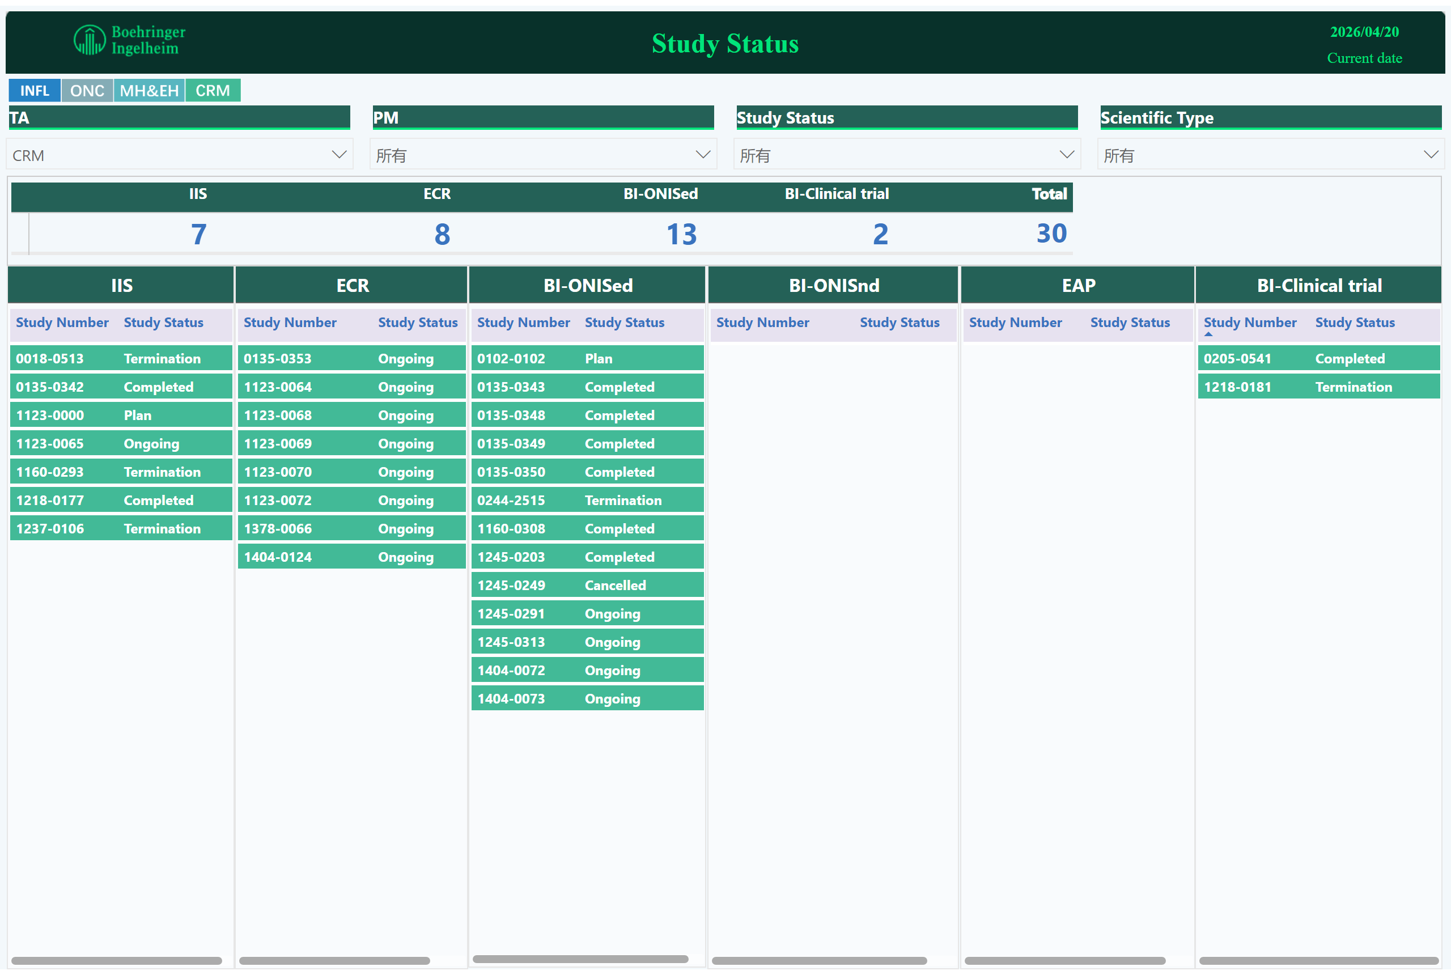
Study Status
TA CRM Portfolio Summary - PMS Studies
1123- Metalyse
0135- Actylise
1404- Survodutide
1245- Jardiance
1378- VicaEmpa
Notes:
ECR
No alt text provided
pivotTable
No alt text provided
image
No alt text provided
textbox
No alt text provided
textbox
No alt text provided
card
No alt text provided
IIS
No alt text provided
slicer
No alt text provided
slicer
No alt text provided
slicer
No alt text provided
slicer
No alt text provided
BI-ONISed
No alt text provided
BI-ONISnd
No alt text provided
EAP
No alt text provided
BI-Clinical trial
No alt text provided
image
No alt text provided

Slide 6
Mature Product/PMS Overview – CRM (Lytics)
Product/Study | Indication | Study type/Global Status (Study no.: FPI-LPO, CTR) | Current status | Next Mile-stone | Key Updates
Metalyse (Metalyse for LVO-AIS at 4.5-24h without thrombectomy under the guidance of NCCT) (Anhui Provincial hospital Prof. Hu) | Acute ischaemic stroke | IIS (1123-0065, Dec 2025-Feb2028, Jul2028) | FPI (Dec2025) | LPI (Nov 2027) | FPI on 1 Dec. 2025 Enrollment progress: 77（+14）/794(actual/plan) Site initiation progress: 30（+4）/60(actual/plan)
Metalyse (Observational RegIstry of Efficacy and safety of teNecTeplase in reAl worLd settings in China (ORIENTAL)) (Chinese Stroke Association, Prof Wang) | Acute ischaemic stroke | ECR (1123-0064; Dec2025-Mar2028; Mar2029) | FPI(Dec2025) | LPI(Jun2028) | SSU Progress Enrollment progress: 223(+146)/10000(actual/plan) as of 31Mar Till 19Apr, enrollment progress 317/10000;
Metalyse (Metalyse before interhospital transfer for thrombectomy in large vessel occlusion at 4.5 to 24 hours(TREASURE)) (Xuanwu Hospital Prof. Hao) | Acute ischaemic stroke | ECR (1123-0068, Dec2025-Sep2027,Dec 2027) | FPI | LPI (Jun 2027) | FPI on 6 Jan 2026 Enrollment status: 8(+4 than last month)/572 (actual/plan) Site activation: 99(+32 than last month)/260 (actual/plan)
Metalyse (Metalyse in late time window (4.5h-24h) with the guidance of NCCT) (Huashan hospital Prof. Cheng) | Acute ischaemic stroke | ECR (1123-0069, Nov2025-Jan2028, Jun2028) | FPI (Nov 2025) | LPI (Oct 2027) | FPI on 10 Nov. 2025 Enrollment progress: 208（+56）/890(actual/plan) Site initiation progress: 40（+5）/51(actual/plan)
Metalyse (Real world effectiveness and safety of thrombolysis with Metalyse in different level of stroke centers in Shandong Province) (Qilu Hospital Prof. Wu) | Acute ischaemic stroke | ECR (1123-0070, Part Ⅰ:Jun2026-Dec2027, Mar2028; PartⅡ: Dec2028) | Contract (Base case:May2026 ; Best case: Feb 2026) | FPI (Base case:Jun2026 ; Best case: Mar 2026) | FPI on 25 Mar. 2026 Enrollment progress: 2（+2）/1000(actual/plan) Site initiation progress: 1/60(actual/plan)
Metalyse (Intra-arterial thrombolysis with Metalyse in MeVo (medium vessel occlusions) (Tiantan hospital Prof. Liu) | Acute ischaemic stroke | ECR （1123-0072, Dec2025-Sep2027, Dec2027） | FPI (Dec 2025) | LPI (Jun 2027) | FPI on 30 Jan. 2026 Enrollment progress: 12（+8）/488(actual/plan) Site initiation progress: 13（+9）/50(actual/plan)
Actylise (Could a subgroup patient with minor nondisabling acute ischemic stroke achieve long-term favourable outcome from thrombolysis intervention: a machine learning analysis) (Zhejiang University, Prof. Lou) | Acute ischaemic stroke | ECR (0135-0353: Sep 2024- Sep 2026) | Data analysis | Final CTR (Jul2026) | Database setup 27Nov2025, Analysis results will be shared before May.

Slide 7
Mature Product/PMS Overview – CRM (Survodutide)
Product/Study | Indication | Study type/Global Status (Study no.: FPI-LPO, CTR) | Current status | Next Mile-stone | Key Updates
Survodutide Cut-off Points of Body Mass Index in China, Japan and the US: A cross-sectional and retrospective cohort study (Peking University, Prof Zhan) | Obesity BMI cutoff definitions among China and Japan | China local NISed (1404.0072:Q4 2024-Q3 2026) | Data analysis | CTR (2026 Jun) | After the Mid-term investigator meeting on Jan 30th , PI is doing the final analysis. Weekly meeting to track the status.
Survodutide Prevalence and clinical characteristics of patients with obesity and metabolic dysfunction-associated steatotic liver disease (MASLD) in China (Peking University, Prof Zhan) | Obesity+MASLD | China local NISed (1404.0073:Q4 2024-Q2 2026) | Data analysis | CTR (2026 Apr) | Study result finalized on Feb 27th, PI is drafting the CTR
Survodutide Clinical characteristics, treatment pattern, and clinical burden of metabolic dysfunction associated steatohepatitis (MASH) in China (The Affiliated Hospital of Hangzhou Normal University, Prof. Shi) | MASH | ECR (1404-0124:May 2026-Sep 2028, Dec 2028) | EC approval | Contract Sign-off (2026 May) | EC approval on 25 Mar 2026 Negotiating the agreement breakdown with PI and legal

Slide 8
Mature Product/PMS Overview – CRM (Jardicance)
Product/Study | Indication | Study type/Global Status (Study no.: FPI-LPO, CTR) | Current status | Next Mile-stone | Key Updates
Jardiance (Empagliflozin) Non-interventional study of the effectiveness and safety of Jardiance in patients with heart failure of reduced ejection fraction (HFrEF) compared to guideline-recommended non-SGLT2i therapy regimens in China (Fuwai Hospital, Prof.Zhang) | HFrEF | China local NISed (1245.0291:Nov 2021-Dec 2030) | IEC approval | Feasibility analysis 1 (2026 Jan) | Current database enrolment delay: due to VBP, and drug switch situation HAI was sent on Jan 20th, feedback on May 14th 2025 Monthly meeting with PI to go through: latest database enrolment, issues, etc Feasibility analysis expected in Apr as we are contacting with PI about the documents
Jardiance (Empagliflozin) A descriptive, non-interventional study of the effectiveness and safety outcomes in patients with heart failure of preserved ejection fraction (HFpEF) who initiate Jardiance in China (Fuwai Hospital, Prof.Zhang) | HFpEF | China local NISed (1245.0313:Q4 2022-Dec 2030) | IEC approval | Feasibility analysis 1 (2026 Jan) | Current database enrolment delay: due to VBP, and drug switch situation HAI was sent on Jan 20th, feedback on May 14th 2025 Monthly meeting with PI to go through: latest database enrolment, issues, etc Feasibility analysis expected in Apr as we are contacting with PI about the documents

Slide 9
Mature Product/PMS Overview – CRM (VicaEmpa)
Product/Study | Indication | Study type/Global Status (Study no.: FPI-LPO, CTR) | Current status | Next Mile-stone | Key Updates
VicaEmpa Prevalence, treatment pattern and outcome of patients with hypertension, type 2 diabetes and established cardiovascular disease (without heart failure) in China (CDC, Prof.Yin) | CVRR | ECR (1378-0066: 2026Dec-2029Mar) | Corporate approval | Protocol approval (2026 Jul) | Kick-off meeting on Mar 12th PI is preparing for the protocol Internally preparing for the contract
VicaEmpa Guideline-directed Medical Therapy Treatment Pattern Among Adults with Chronic Kidney Disease in China: a national wide cross-sectional study (Peking University Third Hospital, Prof.Zeng) | CKD | ONIS (2026Dec-2027Dec) | PEC approval | Concept global approval (OASIS) (2026 Apr) | OASIS submission was rejected by global on Jan 14th as they didn’t finalize the priority of VicaEmpa. May finalize it in Apr and we should wait for the notification The total funding will be confirmed after global finalize their priority Collected the qualification documents from 北三&博睿 and sent to QM, pending by OASIS approval Database authorization document: further reply from legal Sourcing set up of 博睿 encountered issues, discussed the possibility with PI that they outsourced BDS service to 博睿

Slide 10
Survodutide

Slide 11



Survodutide/MASH Development Plan
2024 |  |  |  | 2025 |  |  |  | 2026 |  |  |  | 2027 |  | 2025 |  | 2028 |  |  |  | 2029
Q1 | Q2 | Q3 | Q4 | Q1 | Q2 | Q3 | Q4 | Q1 | Q2 | Q3 | Q4 | Q1 | Q2 | Q3 | Q4 | Q1 | Q2 | Q3 | Q4 | H1 | H2
Global
Accelerated sub/appr (F2/3): Nov 2027/Apr 2028
Ph3-1404.44
FOS trial
19 Oct 2024
May 2027
Jul 2027
Jan 2032
Mar2024
EoP2 sub
MASH F2/3 (n=1800)
FSS
LSR
Interim analysis
DBL
Ph3-1404.64
FOS trial
19 Oct 2024
MASH F4 (n=1590)
Nov 2027
Jul 2029
FSS
LSR
DBL
Full sub/appr (F2-4): Sep2029/Feb 2030
By 17 Apr, LIVERAGE has screened 380 (+105 in Mar, +56 in Apr), randomized 20 (+2 in Mar, +1 in Apr) [50 as planned for Apr]. LIVERAGE-Cirrhosis has screened 104 (+15 in Mar, +7 in Apr), randomized 38(+3 in Mar, +4 in Apr) [10 as planned for Apr].
Part-2 NIT based enrollment HA feedback:​
CDE provided positive feedback on 14th Apr HAI meeting. ​
EMA: NITs alone is still not recommended.
Planning Meeting A for Survodutide MASH submission on May 13th
China
Ph3-1404.44
FOS trial
18 Oct
CTA a
17 Jan
2024
Mar
EoP2 s
6 Aug
CTA s
FSS
Ph3-1404.64
FOS trial
Full sub/appr (F2-3): Nov 2032/Sept 2033 (best) Feb 2034 (base
27 Jan
2024
FSS
We are here
11
Accelerated sub/appr (F2/3): Nov 2027/Aug 2028 (best&base)
Full sub/appr (F2-4): Oct 2029/Jul 2030 (best) Dec 2030 (base

Slide 12


Survodutide/Obesity Development Plan
2023 |  |  |  | 2024 |  |  |  | 2025 |  |  |  | 2026 |  |  |  | 2027 |  | 2028
Q1 | Q2 | Q3 | Q4 | Q1 | Q2 | Q3 | Q4 | Q1 | Q2 | Q3 | Q4 | Q1 | Q2 | Q3 | Q4 | Q1 Q2 | Q3 Q4 | Q1 Q2 | Q3 Q4
Global
25Nov/FSS
Jun/LSR
27 Mar2026/DBL
SYNCHRONIZE-1
Obesity w/o T2DM, N=726
Mar/Jun 2027
Mar/Jun 2028
US approval
15 May2026/DBL
NDA sub
SYNCHRONIZE-2
Obesity with T2DM, N=755
SYNCHRONIZE-1 and –CN TLR global call on 29th Apr.
Synchronize CVOT HKG1 and HKG3 were selected for site GCP inspection from Hong Kong Department of Health in Jun 2026.
US submission shift:, depend on HAI in Nov 2026
Mar 2027 (FDA accepts incomplete stability package) , or ​
Jun 2027 (FDA not accept incomplete package)
SYNCHRONIZE-CVOT
Obesity with CV risk, N=5534
10 Aug /DBL
Aug/LSR
China
30Nov
/CTA appr
27Mar2026/DBL
6Feb/FSS
31Jan/FSS
Jul/LSR
SYNCHRONIZE-1
29 Dec
2022
Mar/CDE feedback
Obesity w/o T2DM, N=64/726
25Aug
15 May2026/DBL
EoP2
CTA + EC + HGRAC + 1st SIV (5M)
Obesity with T2DM, N=78/755
SYNCHRONIZE-2
17Jan/FSS
Aug/LSR
Local communication on TLR:​
SYN-CN: Apr 30th​
SYN-1: May 22nd (CN outputs on May 15)
QC sample testing: meeting with global brand team on Apr 21 (details see next page)
CTA Sub
Obesity with CV risk, N=174+43 (incl TW&HK)/5534
10 Aug /DBL
SYNCHRONIZE-CVOT
25Apr/
EoP2 meeting
31 May
15Sep
Obesity, BMI 24/28 N=307 (56 for MRI-PDFF)
Jul/LSS
SYNCHRONIZE-CN
Pre-IND
30Nov/
CTA appr
6Feb/FSS
Jul 2024
/SIV
Sept 2024/LSS
27 Mar/DBL
CTA Sub
18 Jan
20 Jun 2025/DBL
Jan 2026
CTR
CN PK-1404.13
MRD study design
CTA + EC +HGRAC + 1st SIV (6M)
N=30
CTA Sub
We are here
20 Jan 2027
CN NDA sub
Apr 2028
CN NDA App
(best case)
Jul 2028
CN NDA App
(base case)
TA PEC Portfolio Update| ONLY FOR INTERNAL USE

Slide 13
QC sample request joint discussion (China and Global)
Sharing from China team
Scenarios for QC sample readiness timelines aligned with different approval timelines. Further clarification for QC sample requirements and confirm that the batches of QC samples is not negotiable, based on regulatory requirements and industry intelligence.
Follow up actions
Evaluate the earliest available timing from global team on the 28 batches samples – Global Provide the timeline of the PEN QC Sample availabilities (28 batches for the 2 DS sites) – Global Provide the feasibility evaluation of shifting to CWM to PEN submission possibility – Global & Local Formulate different scenarios for the CN launch (CWM & MASH timing, device format shelf life )– Global & Local

Slide 14
2. Regulatory scenarios with challenges for QC samples
2026
Mar | Apr | May | Jun | Jul | Aug | Sep | Oct | Nov | Dec
2027
Jan | Feb | Mar | Apr | May | Jun | Jul | Aug | Sep | Oct
 |  | 2028
Nov | Dec | Jan | Mar | May | Jul | Sep
Sub.
MAA review
App.
App.
MAA
sub/approval
Jan. 2027
Apr. 2028- 12m*
(Best)
Jul. 2028- 12m*（Base）
Start mgt.
Ready for shipment
Jan 2027.
PPQ batch
(part 1 samples)
Part-1: 13 batches
(11 batches with Sweden DS; 2 batches with Belgium DS)
QC impossible and no MAA approval
Scenario-0
Start manufacturing
Ready for shipment
Sep/Oct. 2027
Commercial production–(part 2)
Current plan
Part 2: 15 batches
(10 batches with Sweden DS; 5 batches with Belgium DS)
Part-1: 13 batches
(11 batches with Sweden DS; 2 batches with Belgium DS)
Ready for shipment
Feb. 2027
Scenario-1
Commercial production–(part 2)
Acc. 7m
Part 2: 15 batches
(10 batches with Sweden DS; 5 batches with Belgium DS)
App.
Apr. 2028
(12m*)
Start manufacturing
Part-1: 13 batches
(11 batches with Sweden DS; 2 batches with Belgium DS)
Ready for shipment
June. 2027
Scenario-2#
Commercial production–(part 2)
Acc. 4m
Part 2: 15 batches
(10 batches with Sweden DS; 5 batches with Belgium DS)
App.
Jul. 2028
(12m*)
Start manufacturing.
Ready for shipment
Sep/Oct. 2027
Commercial production
No Acc. for part 2
New batches
Start manufacturing
Scenario-3
Part 2: 15 batches+13 batches
Total 21 batches: 10+New 11 batches with Sweden DS;
Total 7 batches: 5+New 2 batches with Belgium DS
App.
Sep. 2028
(12~18m@)
*shelf-life months
@ 18m shelf-life: If 18m stability data is available for submission by July 2028, 18m shelf-life is possible granted
# Need negative with NIFDC lab case by case if remaining shelf-life of samples<9months, as this introduces a risk of having no sample with sufficient shelf-life for re-testing if QC results deviate from specifications

Slide 15
Requirements for samples of registration QC testing
Requirements for QC samples are unchanged up to now:
“Samples are of multiple strengths, each of strength is required to provide 3 batches as QC samples*” both for registration QC testing of MAA and post-approval CMC changes.
Survodutide AI project communication milestone for QC samples
Dec 2024: China NDA kick-off had mentioned this QC sample risk
Sep. 2025: Sub HAI to CDE by LRA
Global team prepare questions with position supporting by data in BB
Jan 28. 2026: CMC feedback received from CDE
China local team discuss feedback and aligned the interpretation, also send E-mail to GRA on Jan 28, 2026
Now China team are waiting for global feedback, and it is expected to have further discussion with global CMC team for next mitigation or actions for this feedback.
Mar. 2026: Intelligence from Industry (RDPAC)
Tirzepatide with 4 strengths (Lilly): provide 3 batches for each strength for QC testing
Semaglutide with 5 strengths(Novonordisk): Provide 3 baches for each strength for QC testing
General intelligence: no real case heard to get batch reduction for QC samples except rare disease products or products defined as same formulation cross different strengths of drug product

Slide 16


China NDA submission pathway
2026 |  | 2027 |  |  |  | 2028 |  |  |  | 2029 |  |  |  | 2030
Q3 | Q4 | Q1 | Q2 | Q3 | Q4 | Q1 | Q2 | Q3 | Q4 | Q1 | Q2 | Q3 | Q4 | Q1 | Q2
Current timeline:
Obesity/AI
Having 2 indications (obesity & MASH) in 1 PEN with 1 license in the market is the ultimate goal.
Full dossier ready
Dec
Sub
Jan 2027
Obesity/AI Appr.
Apr – Jul 2028
Obesity/PEN Appr.
Apr – Jul 2029
MASH/PEN
Full dossier ready
Oct
Sub
Nov 2027
MASH/PEN con. Appr.
Nov 2028
Obesity +MASH/PEN
Apr-Jul 2029
NRDL timeline:
NRDL cut-off
Apr. 2029*
NRDL implementation
Jan 2030
To ensure timely NRDL submission in 2029, it is recommended to get NDA approval by the end of April 2029*, MASH approval should be secured by March 2029 (aligned with global brand team). Therefore, the full dossier must be ready by Jan/Feb 2028.
Based on 2025 NRDL adjustment policy, NDA approval cut-off date is end of June. Closely monitor NRDL adjustment policy in following years.

Slide 17
Survodutide – China PI – indication proposal weight reduction
Proposed CN indication – weight reduction
[Local Trade Name] is indicated in combination with a reduced-calorie diet and increased physical activity to reduce excess body weight and maintain weight reduction long term in adults an initial body mass index (BMI) of ≥28 kg/m² (obesity) or ≥24 kg/m² (overweight) in the presence of at least one weight-related comorbid condition (e.g. hypertension, dyslipidaemia, type 2 diabetes mellitus, MASLD, cardiovascular disease, obstructive sleep apnoea, etc.). 本品适用于在控制饮食和增加运动的基础上对成人患者的长期体重管理，初始体重指数（BMI）符合以下条件： ≥28 kg/m²（肥胖），或 ≥24 kg/m²（超重）且伴有至少一种体重相关的合并症，如：高血压、血脂异常、2 型糖尿病、代谢相关脂肪性肝病(MASLD)、心血管疾病、阻塞性睡眠呼吸暂停等。
Comments: The BMI details and comorbid condition is used as target population in SYNCHRONIZE-CN, which follows the suggestion of Technical Guidance on Clinical Trials of Weight Control Drugs, CDE, 2021; The BMI details keep consistency with China local clinical recommendation and practice; The description is aligned with the current approved CWM indication claim in China.

Slide 18
Comparison of the Chinese label
适应症 | Survodutide | 司美格鲁肽（诺和盈） | 替尔泊肽（穆峰达） | 玛氏度肽（信尔美）
中国 | 本品适用于在控制饮食和增加运动的基础上对成人患者的长期体重管理，初始体重指数（BMI）符合以下条件： ≥28 kg/m²（肥胖），或 ≥24 kg/m²（超重）且伴有至少一种体重相关的合并症，如：高血压、血脂异常、2 型糖尿病、代谢相关脂肪性肝病(MASLD)、心血管疾病、阻塞性睡眠呼吸暂停等。 | 本品适用于在控制饮食和增加体力活动的基础上对成人患者的长期体重管理，初始体重指数（BMI）符合以下条件： • ≥30kg/m²（肥胖），或 • ≥27kg/m²至<30kg/m²（超重）且存在至少一种体重相关合并症，例如高血糖、高血压、血脂异常、阻塞性睡眠呼吸暂停或心血管疾病等。 | 长期体重管理 本品适用于在控制饮食和增加运动基础上，用于初始体重指数（BMI)符合以下要求的成人的长期体重管理： ≥ 28kg/m²(肥胖），或 ≥ 24kg/m²(超重）并伴有至少一种体重相关合并症（例如高血压、血脂异常、高血糖、阻塞性睡眠呼吸暂停、心血管疾病等）。 | 本品适用于在控制饮食和增加体力活动基础上对成人患者的长期体重控制，初始体重指数（BMI）为： • BMI ≥ 28 kg/m²（肥胖），或 • BMI ≥ 24 kg/m²（超重），并伴有至少一种体重相关的合并症（例如高血糖、高血压、血脂异常、脂肪肝、阻塞性睡眠呼吸暂停综合征等）。
US | [Local Trade Name] is indicated in combination with a reduced-calorie diet and increased physical activity to reduce excess body weight and maintain weight reduction long term in adults with obesity or adults with overweight in the presence of at least one weight-related comorbid condition. | WEGOVY injection is indicated in combination with a reduced calorie diet and increased physical activity: To reduce excess body weight and maintain weight reduction long term in: Adults and pediatric patients aged 12 years and older with obesity. Adults with overweight in the presence of at least one weight-related combined condition. | ZEPBOUND is a glucose-dependent insulinotropic polypeptide (GIP) receptor and glucagon-like peptide-1 (GLP-1) receptor agonist indicate in combination with a reduced-calorie diet and increased physical activity: To reduce excess body weight and maintain weight reduction long term in adults with obesity or adults with overweight in the presence of at least one weight-related comorbid condition.

Slide 19
Rationales for proposing MASLD as comorbidity
Rationales | Details
MASLD patients in SYNCHRONIZE-CN trial | Although MASH was listed in inclusion criteria , baseline data show 47/306 (15.4 %) patients with MASLD and 17/306 (5.6%) patients with MASH, indicating available data to support
Support from SYNCHRONIZE-MASLD trial | SYNCHRONIZE™-MASLD assessed the effect of survodutide in adults living with overweight/obesity and presumed or confirmed MASH. The adoption of MASLD terminology supports internal consistency across development, scientific communication and labeling strategy.
Clinical & Diagnostic Feasibility | MASH diagnosis remains closely linked to liver biopsy, which is not feasible or scalable in routine obesity management in China. Non‑invasive tests (NITs) are increasingly used in clinical practice and can reliably identify MASLD, but cannot confirm MASH. Retaining MASH would create a disconnect between label language and real‑world diagnosability.
Clinical guideline and market context in China | Chinese obesity and metabolic guidelines recognize obesity/overweight with fatty liver (MASLD) as a relevant comorbidity for the weight management indications. Local competitor (Mazdutide) has obtained obesity indications using fatty liver–based comorbidity language, aligned with its clinical trial population.

Slide 20
CN Participant Discontinuation in SYNCHRONIZE trials (Cut off Date for CN: 30-Jan-2026)
 |  | N | Discontinued prematurely n (%) | PSD* n (%)
SYNCHRONIZE-1 | Global | 725 | 261 (36.0%) | 87(12.0%)
 | China | 64 | 14 (21.8%) | 1 (1.56%)
SYNCHRONIZE-2 | Global | 752 | 250(33.2%) | 60(6.65%)
 | China | 77 | 20 (26%) | 0
SYNCHRONIZE-CVOT | Global | 5510 | 2137 (38.8%) | 281 (5.1 %)
 | China | 174 | 57(32.8%) | 0
SYNCHRONIZE-CN | China | 306 | 58 (18.9%) | 0
* follow-up lost + ICF withdraw;
SYNCHRONIZE-1 Chinese participants have completed LPLV on 9 Jan 2026, global LPLV will be in early Feb.
SYNCHRONIZE-CN has completed LPLV on 28 Jan 2026.
LFU=lost follow-up

Slide 21
Projects/Studies with Red-Light – Hong Kong
Project/study
Red-light starts from
Survodutide, GCGR/GLP-1R dual agonist,
in MASH/1404-0044, PhIII
Aug 2025
Status update
By 10 Apr, HK has screened 24 (+4 in Mar) [26 as planned for Apr 2026], randomized 2 [4 as planned], screen failed 16, in screening 6;
Site Engagement Plan
Site engagement visit planned for HKG1 by monthly by MA.
Site engagement visit planned for HKG2 by monthly by MA.
Other mitigation actions
HKG1 [Prof. Vincent Wong]: Leading the setting up of patient referral network in Hong Kong with HKG2 PI [Prof. Seto]
HKG2 [Prof. Seto]:
  Agreed to prioritize our study by Jul 2026 -- all patients from seminar to our study.
  Lunch meeting under arrangement for study refreshing.

Slide 22
1404-0044 LiverageTM dated on 17Apr2026 (Global recruitment status)
Total Screened = 5782
Total Randomized =472
Total SF=4387
SFR=90.29%
In-screening = 923
Total sample size for part 1 is 700, TCM sample size 12% of 700, ~84
Months | 2024-10 | 2024-11 | 2024-12 | 2025-01 | 2025-02 | 2025-03 | 2025-04 | 2025-05 | 2025-06 | 2025-07 | 2025-08 | 2025-09 | 2025-10 | 2025-11 | 2025-12 | 2026-01 | 2026-02 | 2026-03 | 2026-04 | 2026-05 | 2026-06 | 2026-07 | 2026-08 | 2026-09 | 2026-10 | 2026-11 | 2026-12 | 2027-01 | 2027-02 | 2027-03 | 2027-04 | 2027-05
Screening (planned) | 26 | 41 | 55 | 97 | 246 | 482 | 779 | 1110 | 1491 | 1977 | 2417 | 3028 | 3271 | 3530 | 3788 | 4076 | 4302 | 4584 | 4853 | 5180 | 5666 | 6191 | 6696 | 7235 | 7752 | 8255 | 8795 | 9314 | 9762 | 10135 | 10165 | 10165
Screening (Actual) | 33 | 42 | 55 | 129 | 266 | 534 | 808 | 1145 | 1550 | 1986 | 2402 | 2800 | 3209 | 3629 | 4007 | 4445 | 4887 | 5454 | 5782
Randomized (Planned) | 0 | 1 | 1 | 1 | 3 | 7 | 17 | 31 | 50 | 77 | 106 | 135 | 180 | 232 | 290 | 347 | 401 | 463 | 520 | 580 | 639 | 700 | 811 | 925 | 1041 | 1152 | 1267 | 1382 | 1488 | 1603 | 1712 | 1800
Randomized (Actual) | 0 | 1 | 1 | 1 | 3 | 8 | 18 | 35 | 52 | 78 | 108 | 143 | 194 | 226 | 273 | 333 | 388 | 445 | 472
Clinical Development
and Operations
Notes:
SF: Biopsy (35.43%), data entry pending (10.96%), MRI (9.56%), Fibro (8.62%)

Slide 23
1404-0044 LiverageTM dated on 17Apr2026 (China recruitment status)
Total Screened = 404
Total Randomized = 20
Total SF=248
SFR=92.54%
In screening: 136
ETD: 1
Total sample size for part 1 is 700, TCM sample size 12% of 700, ~84
Months | 2024-10 | 2024-11 | 2024-12 | 2025-01 | 2025-02 | 2025-03 | 2025-04 | 2025-05 | 2025-06 | 2025-07 | 2025-08 | 2025-09 | 2025-10 | 2025-11 | 2025-12 | 2026-01 | 2026-02 | 2026-03 | 2026-04 | 2026-05 | 2026-06 | 2026-07 | 2026-08 | 2026-09 | 2026-10 | 2026-11 | 2026-12 | 2027-01 | 2027-02 | 2027-03 | 2027-04 | 2027-05
Screening (planned) | 0 | 0 | 0 | 0 | 1 | 3 | 9 | 17 | 33 | 60 | 81 | 186 | 226 | 273 | 319 | 366 | 405 | 452 | 492 | 538 | 598 | 658 | 717 | 784 | 843 | 903 | 969 | 1029 | 1089 | 1136 | 1136 | 1136
Screening (Actual) | 0 | 0 | 0 | 1 | 1 | 3 | 12 | 19 | 37 | 61 | 83 | 110 | 142 | 169 | 193 | 223 | 243 | 348 | 404
Randomized (Planned) | 0 | 0 | 0 | 0 | 0 | 0 | 0 | 0 | 0 | 1 | 2 | 4 | 11 | 17 | 24 | 30 | 36 | 43 | 50 | 57 | 64 | 70 | 79 | 89 | 98 | 107 | 117 | 126 | 134 | 144 | 153 | 159
Randomized (Actual) | 0 | 0 | 0 | 0 | 0 | 0 | 0 | 0 | 0 | 1 | 2 | 3 | 4 | 8 | 9 | 17 | 17 | 19 | 20
Clinical Development
and Operations
Notes:
Biopsy 47%, Fibroscan 21%, Patient willing 14%, Lab 12%
上周新增筛选24例：沈阳六院（14例），岳阳市中心医院，吉大一（2例），南昌二院，苏州五院，南京二院，瑞金，邵逸夫，杭州师范，湘雅
目前4月共筛选56例，其中26例来自沈阳六院，30例来自其他研究中心【其他中心呈上升趋势】
上周筛败率增加：2例病理不合格（南京鼓楼，湘雅，邵逸夫），1例Fibroscan（天津二），3例待确认（2例吉大一，1例张晶）,
目前1例合格患者待随机：南京二院，本周随机
ETD – CHN25-004 南京鼓楼 想要备孕

Slide 24
1404-0044 LiverageTM dated on 17Apr2026 (Taiwan recruitment status)
Total Screened = 101
Total Randomized = 7
Total SF=81
SFR=92.05%
In-screening = 13
Months | 2024-10 | 2024-11 | 2024-12 | 2025-01 | 2025-02 | 2025-03 | 2025-04 | 2025-05 | 2025-06 | 2025-07 | 2025-08 | 2025-09 | 2025-10 | 2025-11 | 2025-12 | 2026-01 | 2026-02 | 2026-03 | 2026-04 | 2026-05 | 2026-06 | 2026-07 | 2026-08 | 2026-09 | 2026-10 | 2026-11 | 2026-12 | 2027-01 | 2027-02 | 2027-03 | 2027-04 | 2027-05
Screening (planned) | 0 | 0 | 0 | 0 | 0 | 0 | 1 | 3 | 7 | 13 | 20 | 39 | 46 | 52 | 52 | 59 | 66 | 72 | 72 | 92 | 112 | 139 | 159 | 185 | 205 | 225 | 252 | 272 | 293 | 293 | 293 | 293
Screening (Actual) | 0 | 0 | 0 | 0 | 0 | 0 | 1 | 3 | 8 | 13 | 20 | 34 | 40 | 50 | 78 | 89 | 93 | 97 | 101
Randomized (Planned) | 0 | 0 | 0 | 0 | 0 | 0 | 0 | 0 | 0 | 0 | 0 | 1 | 2 | 2 | 3 | 4 | 5 | 5 | 6 | 7 | 8 | 9 | 12 | 15 | 18 | 22 | 25 | 29 | 32 | 35 | 38 | 41
Randomized (Actual) | 0 | 0 | 0 | 0 | 0 | 0 | 0 | 0 | 0 | 0 | 0 | 1 | 1 | 1 | 2 | 2 | 3 | 6 | 7
Clinical Development
and Operations
Notes:
上周新增筛选2例
有一例病理结果为F4，可以到0064研究

Slide 25
1404-0044 LiverageTM dated on 17Apr2026 (Hong Kong recruitment status)
Total Screened = 24
Total Randomized = 2
Total SF=16
SFR=88.89%
In screening= 6
Months | 2024-10 | 2024-11 | 2024-12 | 2025-01 | 2025-02 | 2025-03 | 2025-04 | 2025-05 | 2025-06 | 2025-07 | 2025-08 | 2025-09 | 2025-10 | 2025-11 | 2025-12 | 2026-01 | 2026-02 | 2026-03 | 2026-04 | 2026-05 | 2026-06 | 2026-07 | 2026-08 | 2026-09 | 2026-10 | 2026-11 | 2026-12 | 2027-01 | 2027-02 | 2027-03 | 2027-04 | 2027-05
Screening (planned) | 0 | 0 | 0 | 0 | 0 | 0 | 0 | 2 | 4 | 4 | 5 | 5 | 12 | 12 | 12 | 19 | 19 | 26 | 26 | 26 | 33 | 48 | 55 | 70 | 84 | 91 | 106 | 120 | 128 | 142 | 150 | 150
Screening (Actual) | 0 | 0 | 0 | 0 | 0 | 0 | 0 | 2 | 4 | 4 | 5 | 5 | 6 | 11 | 15 | 16 | 20 | 24 | 24
Randomized (Planned) | 0 | 0 | 0 | 0 | 0 | 0 | 0 | 0 | 1 | 1 | 1 | 1 | 1 | 2 | 2 | 2 | 3 | 3 | 4 | 4 | 4 | 5 | 6 | 8 | 10 | 11 | 13 | 15 | 16 | 18 | 20 | 21
Randomized (Actual) | 0 | 0 | 0 | 0 | 0 | 0 | 0 | 0 | 1 | 1 | 1 | 1 | 1 | 1 | 2 | 2 | 2 | 2 | 2
Clinical Development
and Operations
Notes:
38% (5)Biopsy (all ballooning), 15% (2)lab results
1例合格患者 HKG1-006，需要复筛，预计4.21回院复筛

Slide 26
Projects/Studies with Red-Light – China Mainland
Project/study
Red-light starts from
Survodutide, GCGR/GLP-1R dual agonist,
in MASH/1404-0044
Aug 2025 (Liverage)
Status Update
Enrolment period of part one is announced to extend to Jul 2026 in late Oct 2025.
Recruitment is behind the plan for LIVERAGETM in China
By 10 Apr, CN has screened 380 (+105 in Mar, +32 in Apr), randomized 20 (+2 in Mar, +1 in Apr) [50 as planned for Apr], screen failed 229, in screening 131 for Liverage
Main challenges for China including intensive competition, high SF rate, site performance low (no scr. >5 weeks since activation)
Site Engagement Plan
By 10 Apr, Totally 202 site engagement visits completed by BI China team.
Global Leadership team for site engagement visit on 13 Apr 2026 for NCIs.
Invited global leadership team for online Monthly NCI Calls for opening remarks.
Enrolment target for Part-1 for high/medium enrolment capability sites were discussed and aligned with local MA team in Mid Jan 2026. Until now, 80% screening and 100% enrollment came from these high performing sites (33 / 57 sites).
Other Mitigation Actions
1st region to implement 1 year free drug supply in late Jan 2026 for both of the studies.
BI-PXL LT Meeting, BI-PXL-SMO LT Meeting, BI-Recruitment Vendor LT Meeting hold in Mar-Apr 2026 for resource and performance issues.
4 new sites selected and 3 about to be initiated by Jul 2026 to have contribution for part-1.
PXL is under investigation with sites for collaboration with 医院体检中心/机构 & 社区医院/下级医院 for patient referral.
  Hospital Health Check-Up Centers: 51 out of 56 sites have health check-up centers, with 35 actively collaborating for patient referrals.​
  Community Hospitals or Free Medical Consultations: 18 out of 56 sites conduct community screening activities.​
  Low translational rate: To date, two patients have been referred from either community screening or health check centers, and neither passed the screening.
Notes:
NCI monthly 中高入组潜力sites （35家）internal evaluation total will have 63; target 96 deliver to site;
3 new sites confirmed 谢青（3+for each project），无锡市第五人民医院；运城市中心医院；
张晶推荐和Echosens合作，PXL+ Echosens + BI 会议1.30；PXL招募和Echosens

Slide 27
Projects/Studies with Red-Light - Taiwan
Project/study
Red-light starts from
Survodutide, GCGR/GLP-1R dual agonist,
in MASH/1404-0044, PhIII
Aug 2025
Status update
By 10 Apr 2026, TW has screened 100 (+7 in Mar/Apr 2026), randomized 7 (+3 in Mar, +1 in Apr) [6 as planned for Apr2026], screen failed 80, in screening 13;
Total 11 site engagement visits completed by BI Taiwan team in early Dec 2025. About ~50% sites lack of enthusiasm in screening but overall screening activities are increased after booster visits.​ second-round booster visits have been completed in Feb/Mar 2026.
Sites intend to identify more accurate patients, focusing population with higher Fibroscan or Fib scores.
Key issues
Recruitment is behind the plan in LIVERAGETM for both global and Taiwan;
Main challenges in Taiwan including high SF rate (Biopsy result failed), half sites not proactive enough with low performance (screen 0-1 patient per month), some (TWN7, 9, 11) sites with insufficient patient pool, 1 site (TWN4) seems decrease interest with competitive studies etc.
Mitigation actions
2nd round site interactions have been completed in Feb/Mar 2026. 3rd round communications for target sites in May 2026 is planned.
Have 1 additional site (TWN12) selected and now under start-up activities, expected the earliest SIV in May 2026.
Pharmacy storage issue of TWN5 is resolved, SIV is planned on 22May2026, CRA now cooperate with site for identifying potential patients.
CRA contact site at least 1 time per week, sites were requested to provide the screening plan in next 2 months for following up.
2 sites are starting using referral materials, and study information/materials posted in public area or shared to district hospital.
Local investigator meeting hold on 14 Mar 2026 successfully.

Slide 28
1404-0064 LiverageTM - Cirrhosis dated on 17Apr2026 (Global recruitment status)
Total Screened = 1955
Total Randomized = 651
Total SF= 1001
SFR= 60.59%
In screening = 343
Months | 2024-10 | 2024-11 | 2024-12 | 2025-01 | 2025-02 | 2025-03 | 2025-04 | 2025-05 | 2025-06 | 2025-07 | 2025-08 | 2025-09 | 2025-10 | 2025-11 | 2025-12 | 2026-01 | 2026-02 | 2026-03 | 2026-04 | 2026-05 | 2026-06 | 2026-07 | 2026-08 | 2026-09 | 2026-10 | 2026-11 | 2026-12 | 2027-01 | 2027-02 | 2027-03 | 2027-04 | 2027-05 | 2027-06 | 2027-07 | 2027-08 | 2027-09 | 2027-10 | 2027-11 | 2027-12 | 2028-01 | 2028-02 | 2028-03
Screening (planned) | 0 | 0 | 0 | 4 | 12 | 26 | 48 | 82 | 132 | 208 | 294 | 398 | 496 | 598 | 714 | 830 | 940 | 1066 | 1184 | 1298 | 1428 | 1556 | 1676 | 1794 | 1916 | 2050 | 2174 | 2294 | 2406 | 2540 | 2652 | 2782 | 2906 | 3030 | 3156 | 3180 | 3180 | 3180 | 3180 | 3180 | 3180 | 3180
Screening (Actual) | 0 | 1 | 2 | 5 | 21 | 52 | 128 | 265 | 447 | 591 | 740 | 899 | 1077 | 1252 | 1380 | 1529 | 1694 | 1883 | 1955
Randomized (Planned) | 0 | 0 | 0 | 0 | 1 | 2 | 6 | 14 | 26 | 43 | 71 | 112 | 156 | 206 | 259 | 310 | 364 | 424 | 478 | 541 | 605 | 660 | 723 | 787 | 848 | 903 | 968 | 1036 | 1090 | 1155 | 1212 | 1282 | 1340 | 1402 | 1463 | 1525 | 1587 | 1590 | 1638 | 1691 | 1740 | 1793
Randomized (Actual) | 0 | 0 | 0 | 0 | 0 | 1 | 10 | 25 | 57 | 106 | 148 | 215 | 281 | 322 | 389 | 454 | 532 | 610 | 651
Clinical Development
and Operations

Slide 29
1404-0064 LiverageTM - Cirrhosis dated on 17Apr2026 (China recruitment status)
Total Screened = 109
Total Randomized = 38
Total SF= 48
SFR= 55.81%
In screening = 23
3 ETD
Months | 2024-12 | 2025-01 | 2025-02 | 2025-03 | 2025-04 | 2025-05 | 2025-06 | 2025-07 | 2025-08 | 2025-09 | 2025-10 | 2025-11 | 2025-12 | 2026-01 | 2026-02 | 2026-03 | 2026-04 | 2026-05 | 2026-06 | 2026-07 | 2026-08 | 2026-09 | 2026-10 | 2026-11 | 2026-12 | 2027-01 | 2027-02 | 2027-03 | 2027-04 | 2027-05 | 2027-06 | 2027-07 | 2027-08 | 2027-09 | 2027-10 | 2027-11
Screening (planned) | 0 | 0 | 0 | 1 | 7 | 11 | 24 | 33 | 37 | 41 | 51 | 61 | 70 | 79 | 90 | 101 | 111 | 121 | 131 | 141 | 151 | 161 | 171 | 180 | 190 | 200 | 207 | 215 | 225 | 235 | 243 | 253 | 261 | 271 | 273 | 273
Screening (Actual) | 0 | 0 | 0 | 1 | 7 | 11 | 23 | 32 | 36 | 40 | 50 | 60 | 73 | 83 | 87 | 102 | 109
Randomized (Planned) | 0 | 0 | 0 | 0 | 0 | 3 | 5 | 10 | 13 | 18 | 19 | 22 | 26 | 30 | 35 | 39 | 44 | 48 | 53 | 58 | 62 | 67 | 71 | 76 | 80 | 85 | 89 | 94 | 99 | 103 | 108 | 112 | 117 | 121 | 126 | 131
Randomized (Actual) | 0 | 0 | 0 | 0 | 0 | 3 | 5 | 10 | 13 | 18 | 19 | 21 | 23 | 27 | 31 | 34 | 38
Clinical Development
and Operations
Notes:
目前有5例合格病人等待入组 （公卫 要登记筛败了，青岛市立，南京鼓楼，北京佑安，浙江邵逸夫）
上周新增筛选5例：南京江宁，南京鼓楼，福建医科大，宁波市二，青岛市立
上周新增2例入组：天津三院，上海东方医院
42% MASH Cirrhosis indication
35% Lab results
1 – Pancreatitis
2 – Work recolation
3 – GI side effects

Slide 30
1404-0064 LiverageTM - Cirrhosis dated on 17Apr2026 (Taiwan recruitment status)
Total Screened = 29
Total Randomized = 8
Total SF= 14
SFR=63.64%
In screening = 7
Months | 2024-12 | 2025-01 | 2025-02 | 2025-03 | 2025-04 | 2025-05 | 2025-06 | 2025-07 | 2025-08 | 2025-09 | 2025-10 | 2025-11 | 2025-12 | 2026-01 | 2026-02 | 2026-03 | 2026-04 | 2026-05 | 2026-06 | 2026-07 | 2026-08 | 2026-09 | 2026-10 | 2026-11 | 2026-12 | 2027-01 | 2027-02 | 2027-03 | 2027-04 | 2027-05 | 2027-06 | 2027-07 | 2027-08 | 2027-09 | 2027-10 | 2027-11
Screening (planned) | 0 | 0 | 0 | 0 | 0 | 0 | 0 | 0 | 1 | 4 | 6 | 10 | 12 | 14 | 16 | 18 | 22 | 24 | 26 | 28 | 30 | 34 | 36 | 38 | 40 | 42 | 46 | 48 | 50 | 52 | 53 | 58 | 60 | 62 | 64 | 66
Screening (Actual) | 0 | 0 | 0 | 0 | 0 | 0 | 1 | 4 | 9 | 10 | 14 | 17 | 20 | 20 | 22 | 28 | 29
Randomized (Planned) | 0 | 0 | 0 | 0 | 0 | 0 | 0 | 0 | 0 | 0 | 2 | 4 | 5 | 6 | 7 | 8 | 10 | 11 | 12 | 13 | 14 | 16 | 17 | 18 | 19 | 20 | 22 | 23 | 24 | 25 | 26 | 28 | 29 | 30 | 31 | 33
Randomized (Actual) | 0 | 0 | 0 | 0 | 0 | 0 | 0 | 0 | 0 | 0 | 2 | 2 | 4 | 5 | 6 | 8 | 8
Clinical Development
and Operations

Slide 31
1404-0064 LiverageTM - Cirrhosis dated on 17Apr2026 (Hong Kong recruitment status)
Total Screened = 14
Total Randomized = 6
Total SF= 2
SFR= 25%
1 ETD
In screening = 6
Months | 2024-12 | 2025-01 | 2025-02 | 2025-03 | 2025-04 | 2025-05 | 2025-06 | 2025-07 | 2025-08 | 2025-09 | 2025-10 | 2025-11 | 2025-12 | 2026-01 | 2026-02 | 2026-03 | 2026-04 | 2026-05 | 2026-06 | 2026-07 | 2026-08 | 2026-09 | 2026-10 | 2026-11 | 2026-12 | 2027-01 | 2027-02 | 2027-03 | 2027-04 | 2027-05 | 2027-06 | 2027-07 | 2027-08 | 2027-09 | 2027-10 | 2027-11
Screening (planned) | 0 | 0 | 0 | 0 | 0 | 0 | 0 | 2 | 4 | 5 | 7 | 7 | 7 | 9 | 10 | 12 | 14 | 16 | 18 | 20 | 22 | 24 | 26 | 28 | 28 | 30 | 30 | 32 | 34 | 36 | 38 | 40 | 42 | 44 | 44 | 44
Screening (Actual) | 0 | 0 | 0 | 0 | 0 | 0 | 1 | 4 | 4 | 6 | 7 | 7 | 7 | 7 | 10 | 14 | 14
Randomized (Planned) | 0 | 0 | 0 | 0 | 0 | 0 | 0 | 0 | 0 | 1 | 2 | 3 | 3 | 4 | 4 | 4 | 5 | 6 | 6 | 6 | 7 | 8 | 9 | 9 | 9 | 10 | 10 | 11 | 12 | 13 | 13 | 13 | 14 | 15 | 16 | 17
Randomized (Actual) | 0 | 0 | 0 | 0 | 0 | 0 | 0 | 0 | 0 | 3 | 4 | 5 | 5 | 5 | 5 | 6 | 6
Clinical Development
and Operations
Notes:
新增1例筛败 HKG2，原因：Inclusion 3，

Slide 32
Projects/Studies with Red-Light – China Mainland
Project/study
Red-light starts from
Survodutide, GCGR/GLP-1R dual agonist,
in MASH Cirrhosis/1404-0064, PhIII
Dec 2025 (Liverage Cirrhosis)
Status Update
Recruitment is behind the plan for Liverage CirrhosisTMin China
By 10 Apr, CN has screened 104 (+15 in Mar, +2 in Apr), randomized 36(+3 in Mar, +2 in Apr) [44 as planned for Apr], screen failed 47, in screening 21 for Liverage Cirrhosis
Main challenges for China including exhausted site resources for patients, site performance low (no scr. >5 weeks since activation)
BI global team has shared their target of enrolment completion by Jul 2027 [Nov 2027 as original plan]
Site Engagement Plan
Strategic site engagement visit arranged upon site tiers. By 10 Apr, Totally 202 site engagement visits completed by BI China team.
Global Leadership team for site engagement visit on 13 Apr 2026 for NCIs.
Invited global leadership team for online Monthly NCI Calls for opening remarks.
Other Mitigation Actions
4 recruitment vendors were involved for Liverage Cirrhosis in Mid Jan 2026
2 new sites selected for Liverage Cirrhosis (Ruijin Hospital with PI Prof. Xie Qing & Shenzhen 3rd hospital with PI Prof. Lu Hongzhou).
1st region to implement 1 year free drug supply in late Jan 2026 for both of the studies.
Notes:
NCI gave goal to all site, screen target weekly at least 1; weekly update in wechat group
NCI lead call zoom online

Slide 33
Projects/Studies with Red-Light – Taiwan
Project/study
Red-light starts from
Survodutide, GCGR/GLP-1R dual agonist,
in MASH/1404-0064, PhIII
Nov 2025
Status update
By 10 Apr 2026, TW has screened 29 (+5 in Mar, +2 in Apr, higher than planned 24), randomized 7 (+1 in Mar) [behind of planned 10], screen failed 13, in screening 8;
Total 11 site engagement visits completed by BI Taiwan team in early Dec 2025. About ~50% sites lack of enthusiasm in screening but 2-3 sites proactively screen for 0064.
TWN11: 1 subject is eligible for biopsy and safety assessment, but with issue of UGE, still under resolving.
TWN9: enrolled 1st subject in Mar 2026, but wrong record in IRT, originally subject should be SF but randomized and discontinued in Feb, the same subject has been re-screened and enrolled in Mar 2026.
TWN10: 2 subjects from 0044 whose pathology report shows F4, both subjects have been screened in Mar.
Key issues
Main challenges in Taiwan including more than half sites not proactive enough with low performance (screen 0-1 patient since SIV), some (TWN7, 9, 11) sites with insufficient patient pool, 1 site (TWN4) seems decrease interest with competitive studies, etc.
All sites booster visits have been completed in early Dec 2025 by CTM/MSL. After the connection, site has increased the screening activities in, but ~50% sites with low enthusiasm should be followed frequently. 2nd round site interactions have been completed in Feb/Mar 2026. 3rd round communications for target sites in May 2026 is planned.
CRA contact site at least 1 time per week, sites were requested to provide the screening plan in next 2 months for following up.
2 sites are starting using referral materials, and study information/materials posted in public area or shared to district hospital.
Local investigator meeting hold on 14 Mar 2026 successfully.
Mitigation actions
Notes:
Financial: 研究者费，提升，逐步审批中；患者补贴，已提交 (Biopsy proposed to Global； MRII, 内窥镜补贴提交global for review) ；患者关怀礼物，已提交，待审批；
Study design: will be discussed with global team
Site engagement
Pt screen number vendor onboard后变化
8 sites are Tier-1 (13); 13 sites are Tier-2 (19)
12 sites are Tier-3 (18); 4 sites are Tier-4 (4)
1 site is Only for Liverage Cirrhosis

Slide 34
VicaEmpa

Slide 35




VicaEmpa/CKD Development Plan (both global and local)
 | 2025 |  |  |  | 2026 |  |  |  | 2027 |  |  |  | 2028 |  | 2025 |  | 2029 |  | 2030 | 2027 | 2031 | 2032
 | Q1 | Q2 | Q3 | Q4 | Q1 | Q2 | Q3 | Q4 | Q1 | Q2 | Q3 | Q4 | Q1 | Q2 | Q3 | Q4 | H1 | H2 | H1 | H2
Ph-III: 1378-0006
DBL: Sep, 2027
(Hybrid-Oxford University)
Approval: Aug, 2028
257 patients randomized in China, with another 230 in the ‘run-in’ period
FSS: Aug, 2025
DBL: Sep, 2027
Approval: Jan, 2029
Approval(Base): Jul.2029
Ph-II: 1378-0023
CTA
FSS: Jun, 2025
DBL: Oct, 2026
Recruitment completed, with 42 patients randomized(10% of total) in China
CTA: Mar, 2025
FSS: Sep, 2025
DBL: Oct, 2026
CTA-EC-HGRAC-1st SIV
Trial duration on base case scenario

Slide 36


VicaEmpa/HF Development Plan (both global and local)
 | 2025 |  |  |  | 2026 |  |  |  | 2027 |  |  |  | 2028 |  | 2025 |  | 2029 |  | 2030 | 2027 | 2030 | 2031
 | Q1 | Q2 | Q3 | Q4 | Q1 | Q2 | Q3 | Q4 | Q1 | Q2 | Q3 | Q4 | Q1 | Q2 | Q3 | Q4 | H1 | H2 | H1 | H2
Ph-III: 1378-0020
DBL: Jul, 2028
(Hybrid-IQVIA)
Approval: Feb, 2029
429 patients randomized in China (4,751 vs. 4,888 planned at global level)
DBL: Jul, 2028
Approval: Sep, 2029
Approval(Base): Mar, 2030
Ph-III: 1378-0018
CTA
FSS: Jul, 2025
DBL: Mar, 2029
(Hybrid-IQVIA)
Approval: Jan, 2030
125(vs. 101) patients randomized in China, and 994(vs. 1,053) patients randomized globally
CTA: Mar, 2025
FSS: Oct, 2025
DBL: Mar, 2029
Approval: Jun, 2030
Approval(Base):
Aug, 2030
CTA-EC-HGRAC-1st SIV
Trial duration on base case scenario

Slide 37

VicaEmpa/CVRR Development Plan (both global and local)
 | 2025 |  |  |  | 2026 |  |  |  | 2027 |  |  |  | 2028 |  | 2025 |  | 2029 |  | 2030 | 2027 | 2030 | 2031
 | Q1 | Q2 | Q3 | Q4 | Q1 | Q2 | Q3 | Q4 | Q1 | Q2 | Q3 | Q4 | Q1 | Q2 | Q3 | Q4 | H1 | H2 | H1 | H2
Ph-III: 1378-0041
CTA
FSS: Jul, 2025
DBL: Jan, 2030
Approval: Mar, 2031
EASi-PROTKT
CTA: 31 May,2025
FSS: Sep ,2025
DBL: Jan, 2030
Approval: Apr, 2031
215(vs. 229 planned) patients randomized in China, and high-speed enrollment was observed at global level ( 4,499 vs. 2,038 planned)
Approval(Base):
Jun, 2031
CTA-EC-HGRAC-1st SIV
Trial duration on base case scenario

Slide 38
Most likely China launch scenario
- waiting for endorsement from BUEC
All regulatory timelines are based on standard assumptions, with submission 1 month after US;
To catch up with NRDL timeline, simultaneous submission will be considered but requiring global support and resource
Indication | Launch scenario | Launch sequence | DBL | Submission | Approval | Launch
CKD | Base case | 3 | 19 Jun 2029 | 08 Nov 2029 | 08 Nov 2030 | 06 Feb 2031
HFpEF | Best case | 1 | 29 Feb 2028 | 20 Jul 2028 | 20 Jul 2029 | 18 Oct 2029
HFrEF | Base case | 2 | 05 Apr 2029 | 25 Aug 2029 | 25 Aug 2030 | 23 Nov 2030
CVRR | Base case | 4 | 01 Feb 2030 | 23 Jun 2030 | 23 Jun 2031 | 21 Sep 2031

Slide 39
1378-0006 EASi-KIDNEY
  Christoph, Salim | 13 Mar 2026 | MS Teams

Slide 40
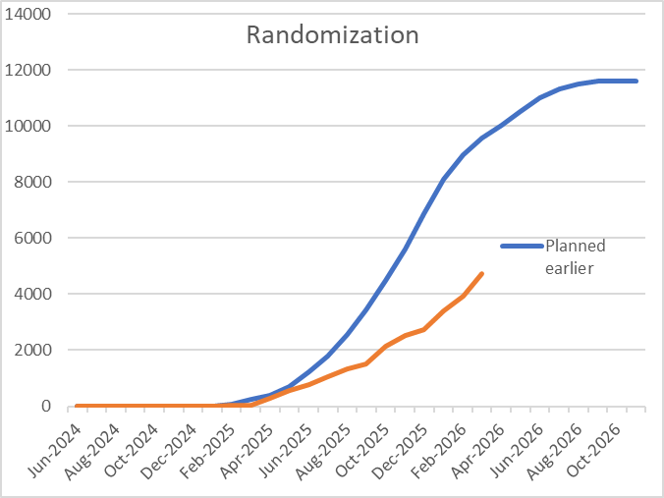
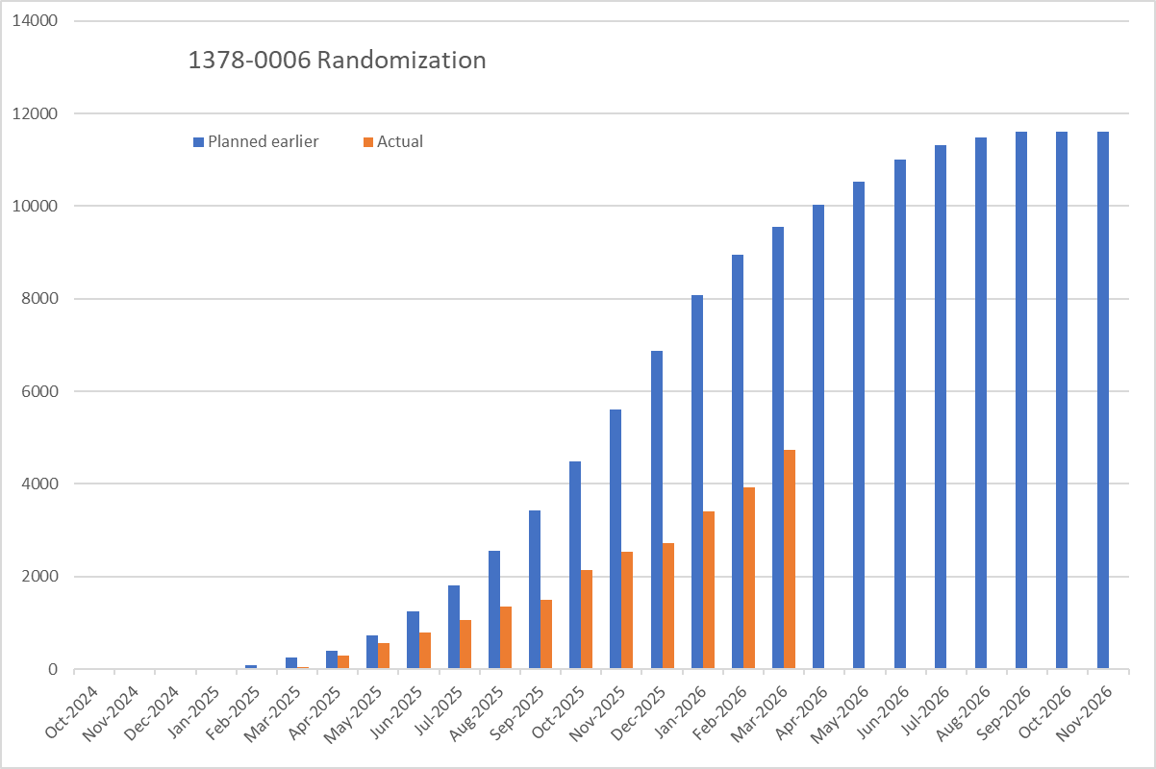
Global randomization progress versus original projections
Planned 9,560 vs Actual 4,743 *until 04th Apr

Slide 41
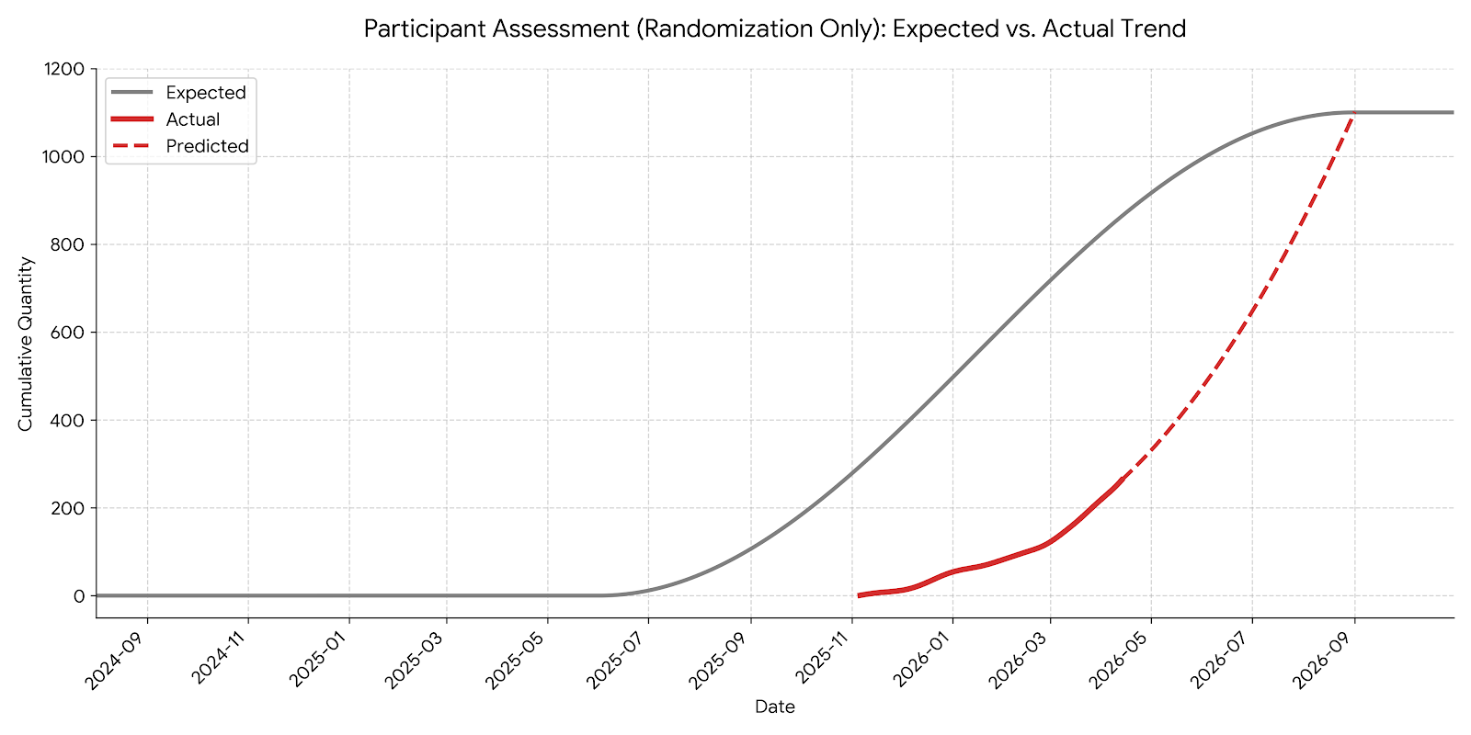
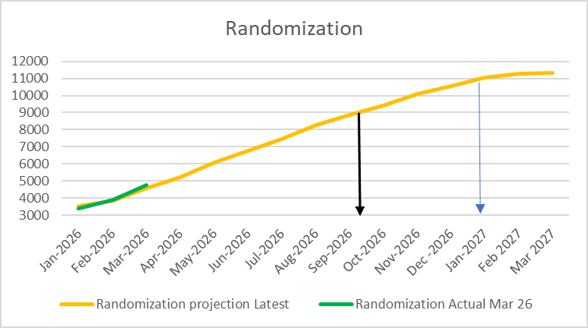
Recruitment Progress in China, and revised projections
Last patient randomised date is re-projected to Jan 2027
As of April 12, 2026
Site Activated | Screened | Run-in period | Randomized
47 | 612 | 230 | 257

Slide 42
Protocol Amendments
Merging DKD and CKD strata§ into one unified population
  Enhance interpretability with a more powerful single primary assessment, new key secondary assessments, while retaining the bility to assess outcomes in patients w/o. T2DM separately
Aims to recruit at least 1/3rd with type 2 diabetes, and 1/3rd without diabetes
Adopting a single hierarchical testing strategy that integrates primary and key secondary*, and expanding key secondary outcomes to kidney failure, HHF or CV death(1st key secondary), emphasising clinically meaningful events
Widened renal eligibility criterion for uACR reduced to ≥150 mg/g for patients without self-reported diabetes; and to ≥30 mg/g for those with self-reported diabetes
  allows for more patients at risk of the primary outcome to join the trial, particularly patients with T2DM who are generally at higher risk of cardiovascular outcomes.
The interim analysis will be applied once on the emerging data after approximately 40% of primary outcome, and 40% of the first key secondary outcome events have accrued; (vs. 60% originally)
§ Stratum 1: 4800 patients with diabetes at baseline, and stratum 2: 6200 patients without diabetes. Generally expecting at least 1/3 with T2DM and at least 1/3 without T2DM after protocol amendment, and no predefined participant ratio will be committed
* Original key secondary outcome: Annual rate of change in eGFR from 1 month until last scheduled visit (i.e. chronic eGFR slope).

Slide 43
1378-0020 EASi-HF Preserved

Slide 44
Site Enrollment Status (cut-off 13Apr2026)
Screen Failure Rate: Global –42.87% (42.82 %), China –38.45% (38.21 %)

Slide 45

EASi-HF preserved - Projected 4.1 Month Acceleration Potential
Predicted Event Rates* Following Capping Indicate a Shortened Trial Duration Via Risk Patient Enrichment
Acceleration Measures Implemented Via Recent CTP Amendment 3.0 (EF) and 4.0 (HHF)
LVEF cap (<60%) and sustained enrollment of prior HHF patients (beyond n=6000) drives estimated event rates up to 15.1/100 pt-yrs - enables faster accrual of the required 912 primary events.
76 new additional sites with high enrollment potential for recently HHF added
Metric | Base Case (Protocol) | Best Case (High‑Risk Enrichment)
Simulated event rates | 7.7 | EF < 60% : 7.0- 8.1** EF < 60% & recent HHF : 12.5- 15.1**
Total trial duration* | ≈45 months | ≈40.9–42.5
4.1m between base and best-case planning
Key Message
Best-case scenario compresses total trial duration (FPI to LPO) to 40.9 months, saving 4.1 months versus base planning*.
*Note: close out period not included in the table. Included in milestones on next slide
**Note: Assumptions based on historical data from similar ph3 trials like FineArts and PAGARON-HF
VicaEmpa update | CRM BUPC Mar 3rd, 2026 | ONLY FOR INTERNAL USE

Slide 46
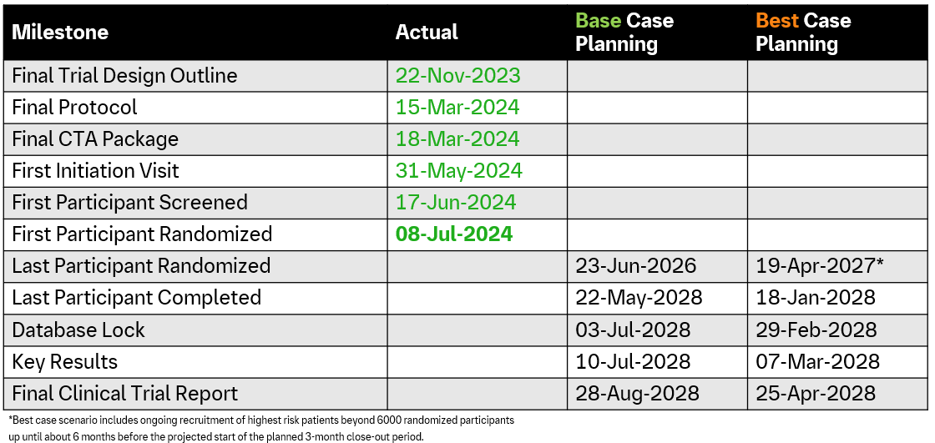
EASi-HF Preserved” – Timelines Base Case vs Best Case
31-Aug- 26: Enrollment target of 6000 pts completed (~2m delay vs base case due to EF ≥ 60% cap)
01-Sep-26: HHF < 6m enrollment cap start (during trial FU)
Longer enrollment period due to EF capping is expected to be offset by faster event accumulation, leading to an overall ~4‑month acceleration
4.1m base vs. best-case
Assumptions of base-case scenario: Event rate for placebo: 7.7
Actual recruitment assumptions; Cap of LVEF >=60% implemented Jan 2026, Cap on no prior HHF implemented Nov 2027

Slide 47
Status Update Summary
Actual event rates are slightly below protocol assumptions, but within manageable range
Mitigation measures implemented and progressing as planned
  EF cap ≥ 60 implemented as of Feb 2026 (Amendment CTP 3.0)
  HHF cap (HHF < 6 month prior to enrollment to be implemented Nov 2026 (applied 6 month during trial FU period)
  Projected Acceleration Potential ~4.1 Month (best case most optimistic scenario)
China has already recruited quite a proportion with highly risky patients
  Excellent recruitment not in terms of quantity, but also quality
 | China | Global
EF<60% | 80% | 70%
HHF within 6 months | 57% | 10%

Slide 48
1378-0018 EASi-HF Reduced
  Thomas | 23 Mar 2026 | MS Teams

Slide 49
Recruitment status_ As of 15Apr2026
Global SF Rate : 43.9%（779/1773） China SF Rate : 34.9%（67/192）

Slide 50
1378-0041 EASi-PROTKT
  Juergen | 23 Mar 2026 | MS Teams

Slide 51
1378-0041 EASi-PROTKTTM dated on 11th April 2026 (Global recruitment status)
Total Screened = 7049
Total Randomized = 4499
Total SF = 1934
SFR = 27%
In screening: 794
Months | 2025–07 | 2025–08 | 2025–09 | 2025–10 | 2025–11 | 2025–12 | 2026–01 | 2026–02 | 2026–03 | 2026–04 | 2026–05 | 2026–06 | 2026–07 | 2026–08 | 2026–09 | 2026–10 | 2026–11 | 2026–12 | 2027–01 | 2027–02
Screening (planned) | 0 | 39 | 86 | 130 | 174 | 793 | 1412 | 2031 | 2649 | 3268 | 3887 | 5317 | 6747 | 8177 | 9607 | 11037 | 12467 | 13897 | 15340 | 15340
Screening (Actual) | 6 | 22 | 114 | 417 | 1146 | 1922 | 3249 | 4733 | 6372 | 7049
Randomized (Planned) | 0 | 6 | 30 | 66 | 100 | 134 | 610 | 1086 | 1562 | 2038 | 2514 | 2990 | 4090 | 5190 | 6290 | 7390 | 8490 | 9590 | 10690 | 11800
Randomized (Actual) | 2 | 14 | 35 | 168 | 485 | 1108 | 1761 | 2807 | 3965 | 4499

Slide 52
1378-0041 EASi-PROTKTTM dated on 11th April 2026(China recruitment status)
Total Screened = 316
Total Randomized = 215
Total SF = 64
SFR = 20%
In screening: 40
Months | 2025–09 | 2025–10 | 2025–11 | 2025–12 | 2026–01 | 2026–02 | 2026–03 | 2026–04 | 2026–05 | 2026–06 | 2026–07 | 2026–08 | 2026–09 | 2026–10 | 2026–11 | 2026–12 | 2027–01 | 2027–02
Screening (planned) | 0 | 5 | 23 | 50 | 88 | 150 | 220 | 300 | 392 | 481 | 588 | 687 | 786 | 880 | 970 | 1022 | 1062 | 1062
Screening (Actual) | 0 | 12 | 55 | 91 | 147 | 172 | 273 | 316
Randomized (Planned) | 0 | 3 | 12 | 25 | 48 | 98 | 164 | 229 | 295 | 360 | 425 | 490 | 545 | 600 | 665 | 730 | 770 | 797
Randomized (Actual) | 0 | 3 | 27 | 57 | 98 | 126 | 185 | 215

Slide 53
1378-0041 EASi-PROTKT™ Hong Kong recruitment - 16-Apr-2026
Aligned with the global team: the HK commitment will be increased to 50 patients.
Months | Oct-25 | Nov-25 | Dec-25 | Jan-26 | Feb-26 | Mar-26 | Apr-26 | May-26 | Jun-26 | Jul-26 | Aug-26 | Sep-26 | Oct-26 | Nov-26 | Dec-26 | Jan-27 | Feb-27
Patients Enrolled/Randomized (Actual) | 0 | 0 | 17 | 20 | 22 | 27 | 28
Patients Enrolled/Randomized (orginial plan) | 0 | 1 | 2 | 4 | 6 | 8 | 11 | 14 | 16 | 20 | 24 | 27 | 30 | 32 | 34 | 35 | 36
Patient Screened(Actual) | 0 | 6 | 20 | 23 | 27 | 32 | 32
Patient Screened(Planned) | 1 | 3 | 5 | 7 | 10 | 13 | 17 | 20 | 24 | 28 | 33 | 36 | 40 | 43 | 48 | 50 | 50

Slide 54
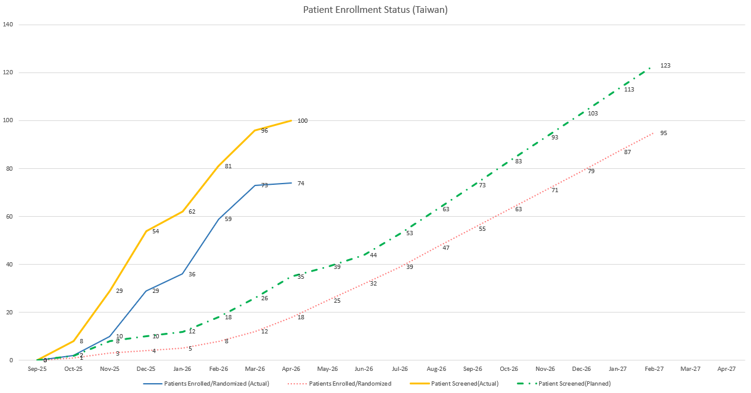
1378-0041 EASi-PROTKT™ Taiwan recruitment status- 21-Apr-2026
Months | Sep-25 | Oct-25 | Nov-25 | Dec-25 | Jan-26 | Feb-26 | Mar-26 | Apr-26 | May-26 | Jun-26 | Jul-26 | Aug-26 | Sep-26 | Oct-26 | Nov-26 | Dec-26 | Jan-27 | Feb-27
Patients Enrolled/Randomized (Actual) | 0 | 2 | 10 | 29 | 36 | 59 | 73 | 74
Patients Enrolled/Randomized (orginial plan) | 0 | 1 | 3 | 4 | 5 | 8 | 12 | 18 | 25 | 32 | 39 | 47 | 55 | 63 | 71 | 79 | 87 | 95
Patient Screened(Actual) | 0 | 8 | 29 | 54 | 62 | 81 | 96 | 100
Patient Screened(Planned) | 0 | 2 | 8 | 10 | 12 | 18 | 26 | 35 | 39 | 44 | 53 | 63 | 73 | 83 | 93 | 103 | 113 | 123
CD&
O Templa
te | ON
Y FOR IL
NTERN
L USEA
10

Slide 55
Actions of Boost Enrollment
Investigator Engagement
Enhancement of site engagement visits
Interim Face to Face Investigator Meeting
  Panel discussion designed to exchange the insights of enrollment from investigators
  High‑recruitment awards to be presented during the meeting
New Site Initiations
List from leading PI’s suggestions
List from the other studies running in cardiovascular departments
Recruitment Vendor Support
Explore the 2nd recruitment vendor to enhance the collaboration of cross departments of the site

Slide 56
Metalyse

Slide 57
TA Portfolio Key Update - Late Stage Assets
Asset Name (MoA) | Indication | China Approval (base case) | Update (please include key achievements, issues/risks, and etc.) | Next Step
Metalyse | AIS Late Window | Jun 2029 | TENACITY (1123-0060) Global: 12/1325 patients randomized China:6/339 patients randomized, 26/55sites actived PersisTENce (1123-0074) CTA submitted on 30 Apr | TENECITY Site initiation activities Enrollment ongoing PersisTENce CTA approval or CDE feedback is expected by 31-Jul-2026.
One HP Priority
TA Priority

Slide 58
Metalyse Development Plan - TENACITY
today
2025 |  |  |  | 2026 |  |  |  | 2027 |  |  |  | 2028 |  |  |  | 2029
Q1 | Q2 | Q3 | Q4 | Q1 | Q2 | Q3 | Q4 | Q1 | Q2 | Q3 | Q4 | Q1 | Q2 | Q3 | Q4 | Q1 | Q2 | Q3 | Q4
Jan 13
Mar 27
4 Nov 2025
Feb 2026
Mar 2027
Jul 2027
Sep 2027
Nov 2027
CTA Review + 1st SIV
Ph3, N=1325
Dec 2028/Jan 2029
EU
NDA sub.
Pre - IND
CTA Sub
1st SIV
LPI
DBL
(Key results +1W)
CSR
NDA app.
Updates (until 22 April):
12/1325 patients randomized
40/235 sites activated
Jan 10
May 28
8 Aug 2025
Feb 2026
Mar 2027
Jul 2027
Sep 2027
China
CTA Review + EC + HGRAC + 1st SIV
Ph3, up to 50 sites, N=~339
Updates (until 22 April):
6/339 patients randomized
26/55 sites activated
1st SIV
LPI
DBL
(Key results +1W)
Pre - IND
CTA Sub
CSR

Slide 59
1123-0060 Tenacity dated on 6May 2026 (Global recruitment status)
Total Screened plan = 1773
Total Randomized plan= 1325
Months | Feb-2026 | Mar-2026 | Apr-2026 | May-2026 | Jun-2026 | Jul-2026 | Aug-2026 | Sep-2026 | Oct-2026 | Nov-2026 | Dec-2026 | Jan-2027 | Feb-2027 | Mar-2027
Screening (planned) | 1 | 9 | 33 | 107 | 225 | 375 | 545 | 727 | 928 | 1131 | 1339 | 1551 | 1743 | 1773
Screening (Actual) | 1 | 6 | 11 | 14
Randomized (Planned) | 1 | 7 | 23 | 74 | 161 | 272 | 401 | 536 | 689 | 837 | 996 | 1156 | 1295 | 1325
Randomized (Actual) | 1 | 6 | 10 | 12
Clinical Development
and Operations

Slide 60
1120-0060 Tenacity dated on 6May 2026 (China recruitment status)
Total Screened plan= 455
Total Randomized plan = 341
Months | Feb-2026 | Mar-2026 | Apr-2026 | May-2026 | Jun-2026 | Jul-2026 | Aug-2026 | Sep-2026 | Oct-2026 | Nov-2026 | Dec-2026 | Jan-2027 | Feb-2027 | Mar-2027
Screening (planned) | 1 | 8 | 24 | 48 | 83 | 123 | 165 | 211 | 250 | 300 | 351 | 402 | 443 | 455
Screening (Actual) | 0 | 2 | 7 | 7
Randomized (Planned) | 1 | 6 | 17 | 36 | 61 | 91 | 123 | 158 | 187 | 224 | 262 | 300 | 332 | 341
Randomized (Actual) | 0 | 2 | 6 | 6
Clinical Development
and Operations

Slide 61
Metalyse Development Plan – PersisTENce
today
2025 |  |  |  | 2026 |  |  |  | 2027 |  |  |  | 2028 |  |  |  | 2029
Q1 | Q2 | Q3 | Q4 | Q1 | Q2 | Q3 | Q4 | Q1 | Q2 | Q3 | Q4 | Q1 | Q2 | Q3 | Q4 | Q1 | Q2 | Q3 | Q4
Global
TENACITY
(accelerated timeline)
CTA Review + 1st SIV
Ph3, N=1325 (China ~ 340pts), 18M
CTA-s
4 Nov 2025
1st SIV
Feb 2026
LPI
Mar 2027
CSR
13 Sep 2027
EU NDA sub.
Nov 2027
EU NDA app.
Dec 2028/Jan 2029
DBL
Jul 2027
China
PersisTENce
Join TENACITY as original plan and conduct a China blinding sister trial in parallel
IMP ready in local depo
CTA submitted on 30 Apr 2026
Nov 2026
*
Decision point
Placebo IMPD Prep**
CTA Review
HAI
N=200 (9 M)
CTA-s
30 Apr 2026
CTA-a*
Aug 2026
EC -approval
LPI
Oct 2027
DBL
Feb 2028
NDA sub.
Jun 2028
NDA app.
Jun 2029
SIV**
Jan 2027
CSR
Apr 2028
*Team will keep close communication with CDE during CTA review. Might need further HAI with CDE after CTA-a depends on CTA feedback.
**Depend on TENACITY enrollment progress and IMP preparation (final decision in April)

Slide 62
Apecotrep

Slide 63
TA Portfolio Key Update - Late Stage Assets
Asset Name (MoA) | Indication | China Approval (base case) | Update (please include key achievements, issues/risks, and etc.) | Next Step
Apecotrep | pFSGS & TRPC6 gain of function mutation related genetic FSGS | Jun 2031 | Global 8/286 participants randomized China 2/25, TW 3/11participants randomized China 14/22, TW 5/9 sites initiated | Site initiation activities Enrollment ongoing
 | Podocytopathies | / | Global FPI on 8 Apr 2026 in TR-pMN cohort in Taiwan China CTA approval on 30 Mar 2026 China fSIV on 20 Apr 2026 | Site initiation activities China IM planned on 24 May
 | DMD | / | Terminated | /
One HP Priority
TA Priority

Slide 64
Apecotrep (TRPC6i), FSGS Development Plan
495 days
399 days
174 days
262 days
261 days
65 days
2025
2031
today
2025
2026
2027
2028
2029
2030
2031
Global
1434-0017
Ph III
final CTA package
9/30/25
N=286
16/2/26 - 10/27/27
global FSS - LSS
May 2030 – May 2031
NDA sub - app
gFPI: 9/3/2026
China
1434-0017
Ph III
10/17/25 - 26/12/25
CTA sub-app
N=36 (mainland and HK 25, TW 11)
3/2/26 – 27/10/27
fSIV - LSS
Jan 1 - Dec 31
China PK study (1434-0025)
Jun 2030 - Jun 2031
NDA sub- app
Site Start up:
  Totally initiated 14 /22 sites
Recruitment:
Global: randomized 8/286
China:​
  Mainland: randomized 2​/25
  Taiwan: randomized 3/11 ​
  Hongkong: no screening
FSS: first subject screened; LSS: last subject screened; FSGS: focal segmental glomerulosclerosis; TRPC6i: transient receptor potential channel 6 inhibitor
Notes:
Site number: China 21， HK 1， TW 6

Slide 65
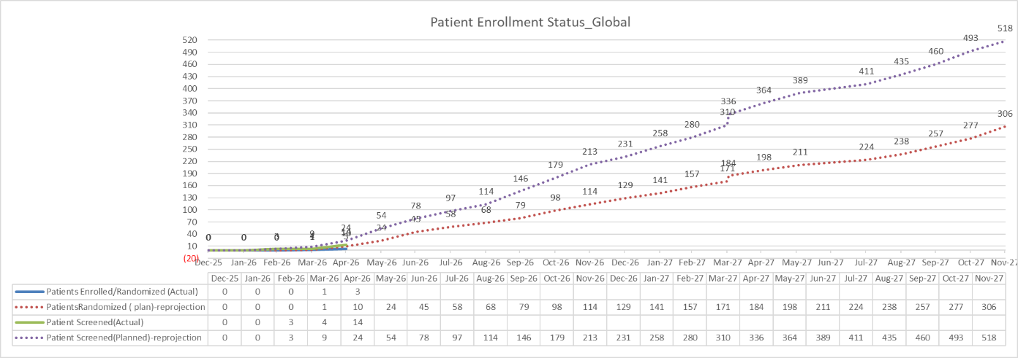
Apecotrep (TRPC6i), 1434-0017 Recruitment Status_Global

Slide 66
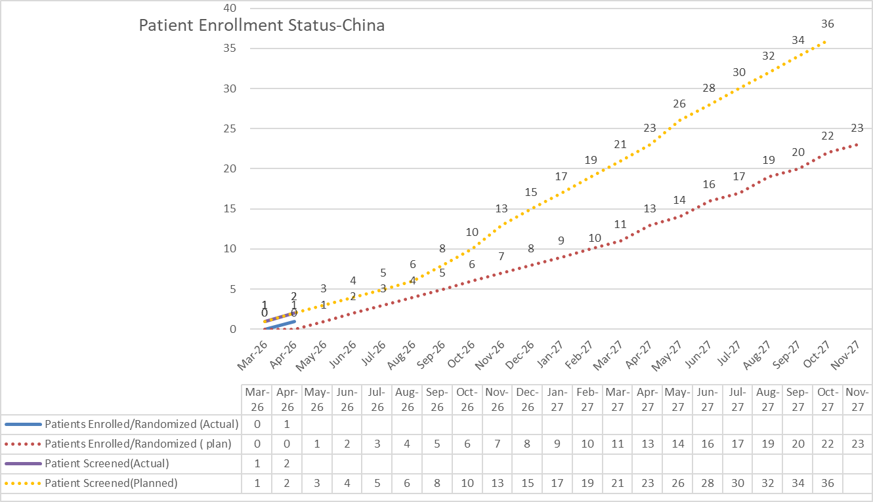
Apecotrep (TRPC6i), 1434-0017 Recruitment Status_China

Slide 67
Apecotrep (TRPC6i), 1434-0017 Recruitment Status_Taiwan
Total Screened: 4
Total Randomized: 1
In screening: 2
Screen failure: 1
Months | Jan-26 | Feb-26 | Mar-26 | Apr-26 | May-26 | Jun-26 | Jul-26 | Aug-26 | Sep-26 | Oct-26 | Nov-26 | Dec-26 | Jan-27 | Feb-27 | Mar-27 | Apr-27 | May-27 | Jun-27 | Jul-27 | Aug-27 | Sep-27 | Oct-27 | Nov-27
Patients Randomized (Actual) |  | 0 | 0 | 1
Patients Randomized (Plan) |  | 0 | 0 | 1 | 1 | 2 | 2 | 3 | 3 | 4 | 4 | 5 | 5 | 6 | 6 | 7 | 7 | 8 | 8 | 9 | 10 | 11 | 11
Patient Screened(Actual) |  | 0 | 4 | 4
Patient Screened(Planned) |  | 0 | 1 | 2 | 3 | 4 | 5 | 5 | 6 | 6 | 7 | 8 | 9 | 9 | 10 | 11 | 11 | 12 | 13 | 13 | 14 | 14 | 14
Clinical Development
and Operations

Slide 68
Apecotrep (TRPC6i), Podocytopathies Development Plan
381 days
289 days
69 days
64 days
2025
2028
today
2025
2026
2027
2028
Today
Global
1434-0027
Ph II
Final CTA package
11/28/25
N=132
2/20/26 - 7/22/27
FSIV - LSS
key results
4/16/28
China
1434-0027
Ph II
7/11/25 - 10/9/25
pre-IND sub - feedback
12/12/25 - 3/30/26
CTA sub-app
N=14 (mainland 10, TW 4)
6/12/26 - 7/22/27
fSIV - LSS
Global: FPI on 8 Apr 2026 in TR-pMN cohort in Taiwan, screened :2 (1 randomized, 1under screening)
China CTA approved on 30-Mar-2026
China fSIV happened on 20 Apr 2026 in Peking University First Hospital
Local IM planned on 24 May in Beijing

Slide 69
289 days
179 days
65 days
30 days
2025
2028
Apecotrep (TRPC6i), DMD Development Plan — Terminated
2025
2026
2027
2028
Today
pre-IND sub
11/26/25
Global
1434-0019
Ph II
Final CTA package
4/10/26
6/16/26 - 7/26/27
FSS- LSS
key results
5/4/28
China
1434-0019
Ph II
19/12/25 – 30/1/26
pre-IND sub - feedback
5/17/26 - 8/14/26
CTA sub-app
N=5 (mainland 3, HK 2)
11/17/26 - 7/26/27
fSIV- LSS
Pre-IND submitted on 19-Dec-2025, and feedback received on 12 Jan without critical comments
Final TDO was completed on 24Feb2026. Global allocated 4 sites & 3 pts in Chinese Mainland; 1 site & 2 pts in HK.
Leading PI selection under discussion (北京协和-戴毅；北京儿童医院-熊晖). CTM will schedule a meeting with team within this week.
China PAB meeting is planned in the week of 23Mar2026.
FSS: first subject screened; LSR: last subject randomized; FSGS: DMD: Duchenne Muscular Dystrophy; TRPC6i: transient receptor potential channel 6 inhibitor

Slide 70
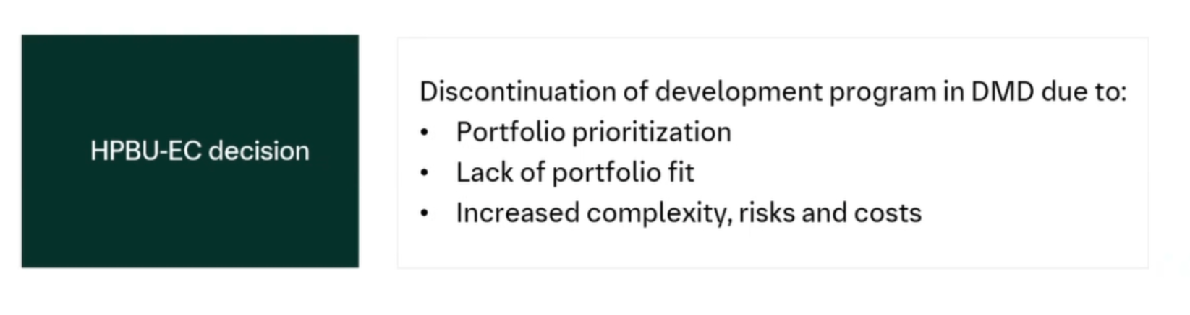
Rationale for termination of Apecotrep (TRPC6i) DMD

Slide 71
Early Assets
BI 3034701 (GGY2Ra.)
BI 3802876 (FAP/TRAILR2)
BI 3802876 (Anti-TLR4 mAb)

Slide 72
BI 3034701 (GGY2Ra.)

Slide 73
BI 3034701 (GGY2Ra.), Obesity China Development Plan
96 days
65 days
65 days
47 days
2025
2026
2027
2028
Q1
Q2
Q3
Q4
Q1
Q2
Q3
Q4
Q1
2028
Today
Global
1507-0002 Ph II
22/6/26 – 22/9/26
Final CTA package
gFSS – LSS
13/3/26
IA for Go/No-Go
22/2/27
HPEC
Strategic direction
24/06/26
1507-0010 Ph III
1/3/27 – 24/9/27
gFSS - LSR
DBL
14/1/29
FDA Type C
Aug/26
Ph III CTA sub
31/10/26
China
1507-0002 Ph II
CTA sub - app
1507-0002 Ph II
16/8/26 – 22/9/26
Ph II pre-IND
China fSIV – LSS (Recruitment window: 1-2M, 25 pts, 8 sites)
3/4/26 – 30/6/26
1507-0010 Ph III
Ideal scenario based on assumptions. More scenarios are under development and will be adapted according to the changing global scenarios.
CDE Type II
Oct/26
Ph III CTA sub
30/11/26
CN Ph III with low BMI
CN PK
Global:
Decision point: HPEC to endorse strategic direction by 24 Jun.
FDA Type C (post-decision): to confirm Ph2 to Ph3 transition plans and key Ph3 design, aiming to skip a typical EOP2 and directly initiate Ph3 after IA (2027Feb).
China:
China local workshop (21 Apr): Scenario-based alignment under evolving global assumptions — China indication focus, development scenarios & timeline, trial priorities, sample size range, and CMC/device considerations.
Next step:
  Align China strategy with global team
  Prepare CDE Type II meeting following FDA Type C

Slide 74
China Leading PI Selection for 1507-0010 (GGY2Ra in obesity, Phase III) study
To insert a wordmark:
Add (e.g. via drag and drop) your wordmark file (in RGB) to this slide (in alignment with our brand governance and architecture guidelines)
Change the size of the wordmark according to the height reference (magenta placeholder)
Select the “guides” in the navigation bar and move the wordmark to the right and top line (orange)
China CDO & TA team
23Apr2026

Slide 75
Executive Summary
Background
BI 3034701 (GGY2Ra.) is a GLP-1R, GIPR and NPY2R triple agonist being developed in obesity.
PoC has been achieved based on Ph I SRD/MRD data.
China plans to join the global Ph III study, 75 sites & 585 pts were allocated to China; country feasibility is underway. (global 5850 pts)
Key Message/Rationale
Tight timeline in the study.
4 months from CTA package to first subject in.
5.7 months for enrollment duration.
Leading site should be initiated with fast SSU timeline (<4 months) .
Leading PI needs to have influence in China to engage other investigators on recruitment and patient retention.
Team Recommendations
Prof. Linong Ji (纪立农) from 北京大学人民医院

Slide 76
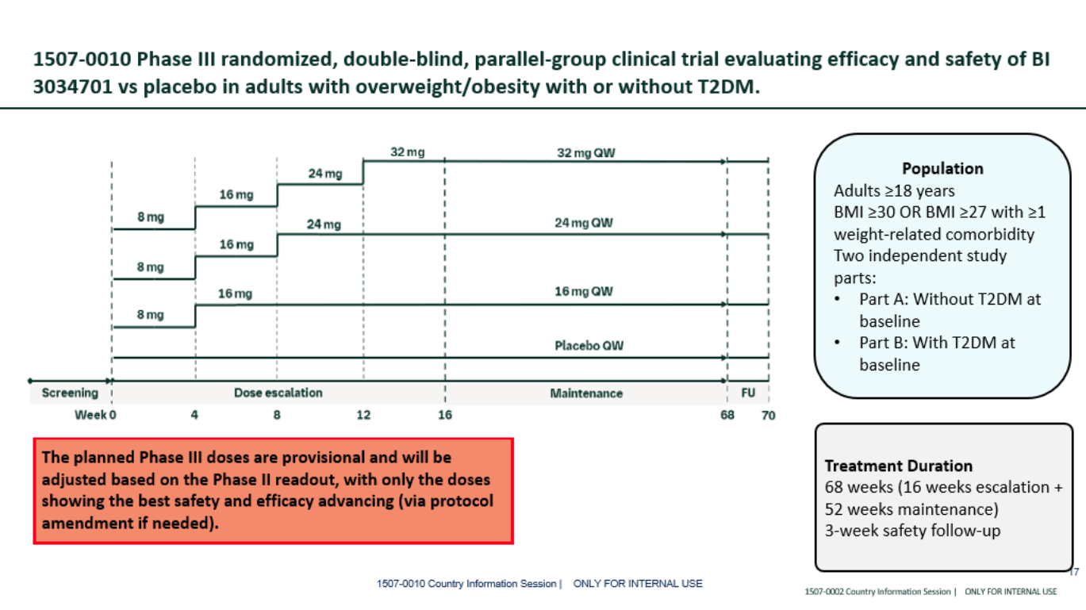
Phase III trial design (1507-0010) DRAFT_ design as of 24Mar2026 for dose strategy consideration

Slide 77
BI 3034701 (GGY2Ra.) China Development Plan
96 days
65 days
65 days
47 days
2025
2026
2027
2028
Q1
Q2
Q3
Q4
Q1
Q2
Q3
Q4
Q1
2028
Today
Global
1507-0002 Ph II
Jun/26 - Oct/27
Final CTA package
gFSS – key results
13/3/26
IA for Go/No-Go
Q1/27
HPEC
24/06/26
FDA Type C
Aug/26
Ph III CTA sub
1507-0010 Ph III
Feb/27 – Q4/28
gFSS - LSS
Oct/26
China
1507-0002 Ph II
CTA sub - app
1507-0002 Ph II
16/8/26 – 22/9/26
Recruitment window: 1-2M (25pts, 8 sites)
Ph II pre-IND
China fSIV - LSS
3/4/26 – 30/6/26
CDE Type II
Sep/26
1507-0010 Ph III
Mar/27 – Q4/28
Ph III CTA sub
CN Ph III with low BMI
FSS - LSS
Nov/26
CN PK
Ph3-CN:
Type II meeting: Sep/2026.
CTA submission: Nov/2026.
Local workshop (Apr 22nd) to align on China strategy including separate Ph3 with low BMI, CN PK studies, etc.

Slide 78
Phase 3 Design_Updated Global Sample Size N=5850
Global team plan to allocate 75 sites and 585 pts to China.
Milestone | Global Timeline | China Timeline (based on 6-month benchmark from CTA submission to fSIV) | China Timeline (based on 1404-0061 4-month from CTA submission to fSIV)
Final CTA Package | 31Oct2026 | 31Oct2026 | 31Oct2026
CTA Submission |  | 30Nov2026 | 30Nov2026
CTA Approval |  | 29Jan2027 | 29Jan2027
First Site Initiated | 01Mar2027 | 28May2027 | 31Mar2027
First Subject Randomized | 08Mar2027 | 04Jun2027 | 03Apr2027
Last Subject Randomized | 01Aug2027 | 01Aug2027 | 01Aug2027
Enrollment Duration | ~5 months for pt with T2DM ~6.8 months for pt without T2DM | < 2 months for pt with T2DM < 3.8 months for pt without T2DM | ~4 months for pt with T2DM ~5.8 months for pt without T2DM

Slide 79
Potential Leading PI Discussed with Evidence Team
Leading PI | Site Name | Comments
纪立农 | 北京大学人民医院 | Recommend; refer to the following slides for details
洪天配 | 北京大学第三医院 | Site can be initiated in 3.3 months even in the 60-WD CTA path; PI is around 64 years old; PI only leads 4 clinical trials so far (lower influence compared with 纪立农）
李小英 | 复旦大学附属中山医院 | Former Department Head of Endocrinology
张惠杰 | 复旦大学附属中山医院 | No Leading PI experience (nominated by MA team) Current Department Head of Endocrinology
毕 艳 | 南京鼓楼医院 | Only lead one ph1/2 local PK study 信达-玛仕度肽 in 2025 (nominated by MA team)
刘 铭 | 天津医科大学总医院 | 60 years old; Site usually takes 5 months from CTA submission to SIV
陈莉明 | 天津医科大学朱宪彝 纪念医院 | -Site usually takes 5 months from CTA submission to SIV. -EC secretary concurrently serves in the disciplinary committee(纪委), is always too busy to respond. No one can push her. -EC meeting was delayed for 1 month in the 1507-0002 ph2 study.

Slide 80
Leading PI information collection & evaluation (only for internal reference)
Potential investigator name** | Hospital/ department | Academic experience, especially in clinical studies(weight 15%**) | Impact in Therapeutic Area (weight 20%**) | Leading PI feasibility(weight 30%**) | Leading site start up timeline feasibility(weight 35%**) | Total Grade | Finial proposal for leading PI selection (Y/N)
纪立农 | 北京大学人民医院 | Grade: 13 Postdoc fellow at Joslin Diabetes Center, Harvard Medical School, US Leading PI of 136 clinical trials as per the CDE website including all well-known products in the field 500+publications on Pubmed Research focus: T2D and obesity | Grade: 18 Director of Peking University Diabetes Center Director of the Department of Endocrinology and Metabolism President of the Chinese Geriatric Endocrine and Metabolism Society, Chairman of the Diabetes and Metabolic Disease Committee of China Pharmaceutical Innovation and Research Development Association, Vice President of the Chinese Endocrinologist Association, Vice President of China Stroke Society and Executive board member of the Asia Association for the Study of Diabetes. Additionally, he is a member of the International Diabetes Federation Western Pacific Region (IDF-WPR) diabetes policy group and a World Health Organization Consultant on the Definition, Diagnosis and Classification of Diabetes Mellitus. Professor Li’s previous roles include Chair of the IDF-WPR (2018–2019), President of the Chinese Diabetes Society (2009–2012) and Vice President of IDF Global (2012–2015) | Grade: 28 63 years old Prof. Ji with rich clinical trial experience, he took 135 trials as leading PI. Prof. Ji is the leading PI of Synchronize-1/ 2/ CN(1404-0038/41/61) Leading PI for Empagliflozin BI clinical trial 1479-0001 during 2020 to 2022. BI keeps good communication with Prof. Ji. | Grade: 32 1. GCP set up and review 30-WD CTA application is available at the Endocrinology department It routinely takes 1 week, if it required EC is in parallel to CTA, may apply for EC and HGRAC firstly. and then proceed the setting-up process. 2. EC It‘s feasible to keep EC in parallel to CTA. But there is risk that EC will not release formal EC approval before CTA approval if follow the 60-WD CTA process. It routinely takes 1 month. 3. HGRAC It takes 1-2 weeks for HGRAC application and 1-2 weeks for obtaining the signature and seal, this site has previously applied for HGRAC exportation and obtained approval. The CIQ account is available in this site. 4. Contract The site contract review takes 1-2 weeks, and the contract seal takes 1-2 weeks. The down payment requires a complete and assessable subject fee. To sum up, the timeline of the SSU usually take 4-4.5 months(4 mon. in 1404-0041 study) under normal 60-WD CTA process. | 91 | Y
北京市药品监督管理局关于发布第二批优化创新药临床试验审评审批 试点药物临床试验机构的公告

Slide 81
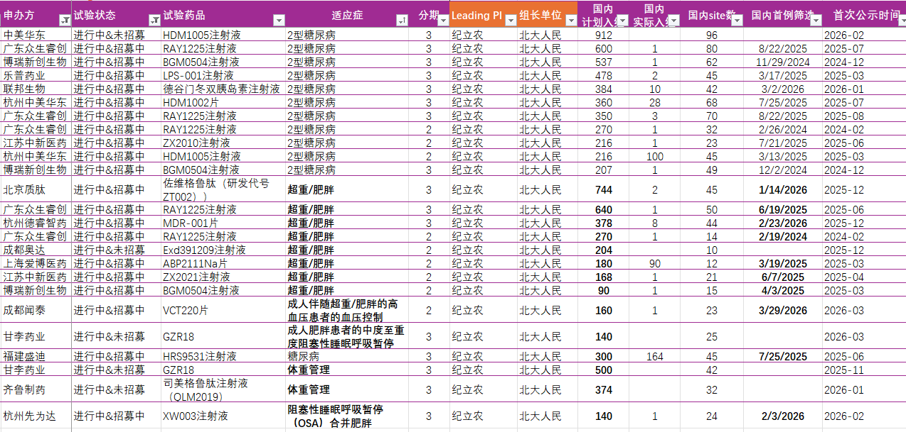
CDE registered Phase 3 Trials_纪立农
登记号 | 申办方 | 试验状态 | 试验药品 | 适应症 | 分期 | Leading PI | 组长单位 | 国内 计划入组 | 国内 实际入组 | 国内site数 | 国内首例筛选 | 首次公示
CTR20260922 | Eli Lilly | 进行中&未招募 | Eloralintide注射液 | 肥胖或超重 | 3 | 纪立农 | 北大人民 | 80 | NA | 15 | NA | 2026-03
CTR20254568 | Eli Lilly | 进行中&招募中 | Orforglipron片 | 在已确诊动脉粥样硬化性心血管疾病和/或慢性肾脏病的患者中降低主要心血管不良事件风险 | 3 | 纪立农 葛均波/王箴 | 北大人民 复旦中山 | 299 | NA | 29 | NA | 2025-11
Other 25 trials of local Parma companies are ongoing for recruitment

Slide 82
Leading PI information collection & evaluation (only for internal reference)
Potential investigator name** | Hospital/ department | Academic experience, especially in clinical studies(weight 15%**) | Impact in Therapeutic Area (weight 20%**) | Leading PI feasibility(weight 30%**) | Leading site start up timeline feasibility(weight 35%**) | Total Grade | Finial proposal for leading PI selection (Y/N)
洪天配 | 北京大学第三医院/内分泌科 | Grade: 12 Main research areas include basic and clinical research on diabetes, endocrine metabolism, and reproductive health research. Leading PI of 4 ph-III pivotal trials in CWM, T2D and obesity related complications Presided over more than 30 national and provincial-level research projects, including 9 National Natural Science Foundation of China projects and 2 National Key Research and Development Program projects. Published over 110 SCI papers in renowned journals such as JAMA, Metabolism, Diabetologia, and Diabetes etc. | Grade: 16 Director of Endocrinology Department, PUTH President elect of the 6th Committee of the Endocrinology and Metabolism Physician Branch of the Chinese Medical Association/中国医师协会内分泌分会 | Grade:25 Get PhD in 1991, around 64 Y Lead 4 ph3 studies, Lilly’s 2 ongoing pivotal trials : China coordinator of Orforglipron’s ph-III for CWM and T2D, 2 for local pharma, including Innovent’s 1 ongoing trial for Mazdutide’s mild to severe OSA | Grade: 34 GCP set up and review 30-day CTA application is available at site for all departments as leading site(CRA called GCP office on 17Apr2026 and confirmed.) 1 week for GCP set up completed, based on timeline in the 1378-0041 study(same site, different PI). The following timeline is also based on 1378-0041study. 2. EC EC submission is allowed without CDE clinical trial notification; 5 weeks from EC submission to EC approval. 3. HGRAC 1 week from HGRAC submission to Approval (备案) 4. Contract around 2 months from contract submission to PI to signed off. 7 WDs for signature at site. To sum up, it took 3.7 months from CTA submission to SIV at site. Yet country team waited for nearly 22 calendar days from HGRAC approval to SIV. This is due to the IMP issue from global team. The fastest timeline from CTA submission to SIV would be around 3.3 months under the normal CTA submission path. | 87 | N
关于发布第一批优化创新药临床试验审评审批试点药物临床试验机构的公告
Notes:
河南科技大学附属第一医院

Slide 83
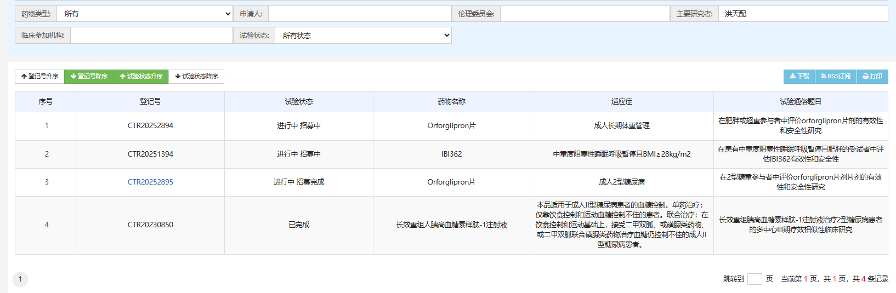
CDE registered Phase 3 Trials_洪天配
登记号 | 申办方 | 试验状态 | 试验药品 | 分期 | 适应症 | Leading PI | 组长单位 | 国内 计划入组 | 国内 实际入组 | 国内 site数 | 国内首例筛选
CTR20252894 | Eli Lilly | 进行中 | Orforglipron片-化药 | 3 | 肥胖或超重参与者成人长期体重管理 | 洪天配 | 北京大学第三医院 | 120 | 89 | 12 | 8/7/2025
CTR20252895 | Eli Lilly | 进行中 | Orforglipron片-化药 | 3 | 合并2型糖尿病的肥胖或超重 | 洪天配 | 北京大学第三医院 | 60 | 30 | 12 | 8/7/2025
Only 4 trials registered in total

Slide 84
Leading PI information (Leading PI in the 1507-0002 Ph2 study)
Potential investigator name** | Hospital/ department | Academic experience, especially in clinical studies(weight 15%**) | Impact in Therapeutic Area (weight 20%**) | Leading PI feasibility(weight 30%**) | Leading site start up timeline feasibility(weight 35%**) | Total Grade | Finial proposal for leading PI selection (Y/N)
陈莉明 | 天津医科大学朱宪彝纪念医院（代谢病医院） | Grade：11 Leading PI of 7 clinical trials in diabetes all sponsored by local companies PI of mazdutide in MAFLD/Innovent, survodutide in obesity/Boehringer, Orforglipron/Lily, Empa in T2D/Boehringer etc. 150+publication on Pubmed Research focus: diabetes, diabetic kidney disease | Grade：17 Head of Endocrinology Department Dean of the hospital Next Chair（候任主委）of Chinese Diabetes Society (中华医学会糖尿病学分会） | Grade：25 Prof. Chen,58 years old Prof. Chen took 7 trials as leading PI but all of them are Diabetes by local companies. Current Director of the Metabolic Disease Hospital at Tianjin Medical University, it’s difficult to get in touch with her, getting her signature always takes a long time(need to contact through GCP office). | Grade：27 1.GCP set up and review, It routinely takes 2 week, if it required EC is in parallel to CTA, may apply for EC and HGRAC firstly. and then proceed the setting-up process . 2. EC need CTA acceptance to start the EC application. There is no regular EC meeting at site, normally every 2-3 month. EC won’t share the meeting date until 2-3 days before the meeting. The timeline cannot be estimated (experience from the 1507-0002 study). EC secretary concurrently serves in the disciplinary committee, is always too busy to respond. PI is the president of site, usually takes longer time to sign the submission documents. 3. HGRAC. It takes 2 weeks for HGRAC application and 2 weeks for obtaining the signature and seal, this site has previously applied for HGRAC exportation and obtained approval. The CIQ account is available in this site. 4. Contract. The site contract review takes 4-6 weeks, and the contract seal takes 2 weeks. The down payment requires a complete and assessable subject fee. To sum up, the timeline of the SSU in this site meets the 6 months benchmark of BI, usually takes 5 months. | 80 | N

Slide 85
Backup

Slide 86
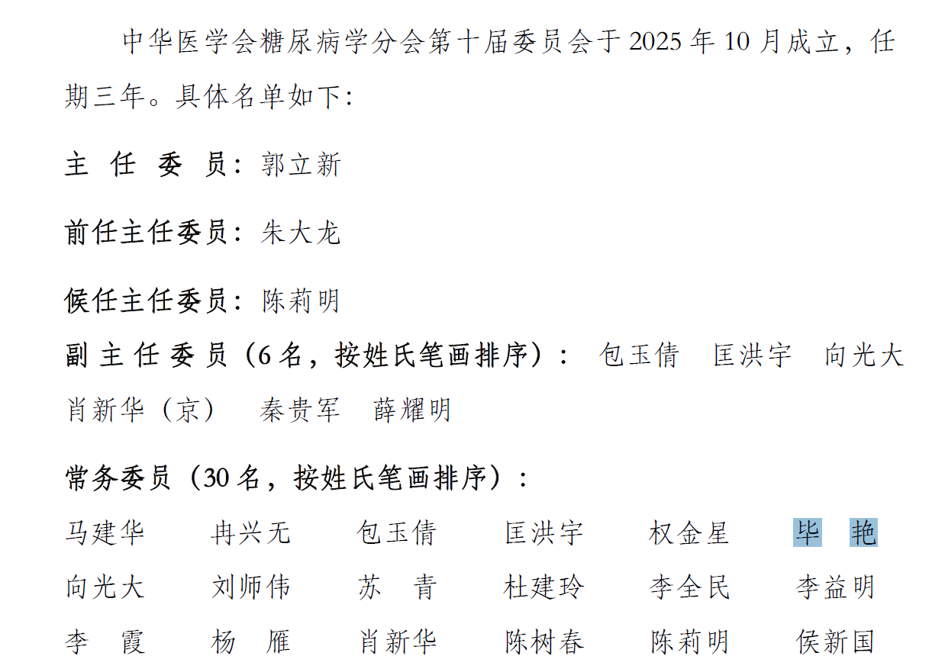
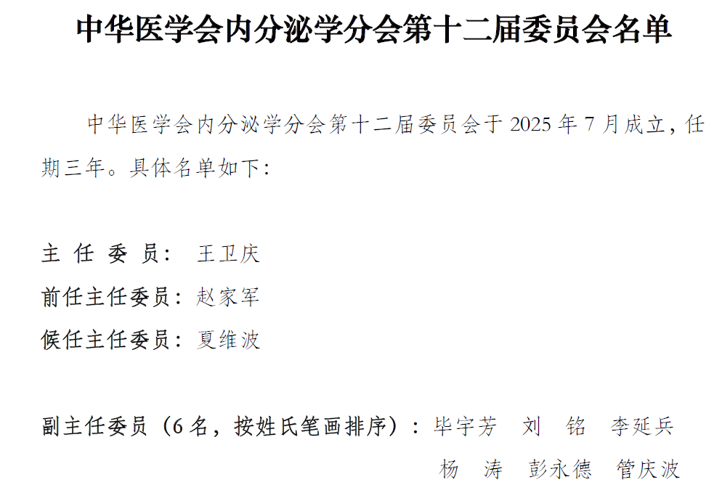
*王卫庆：长期专注于转化医学研究 ，主要从事内分泌肿瘤诊治、代谢性疾病防控与标准化管理等工作。
*夏维波：骨质疏松和骨矿盐疾病方向
*郭立新：CDE登记 11 个进行中招募中的试验

Slide 87
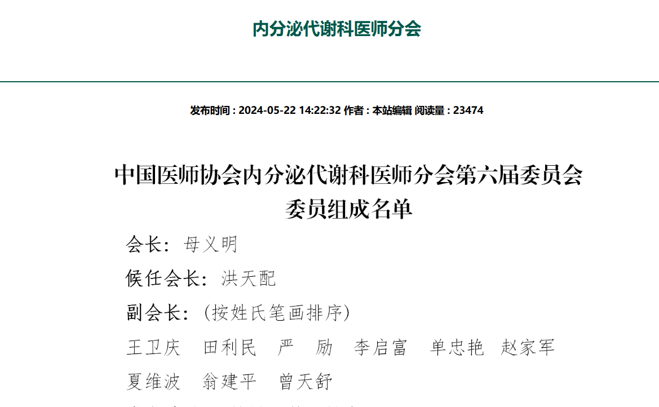
中国医师协会

Slide 88
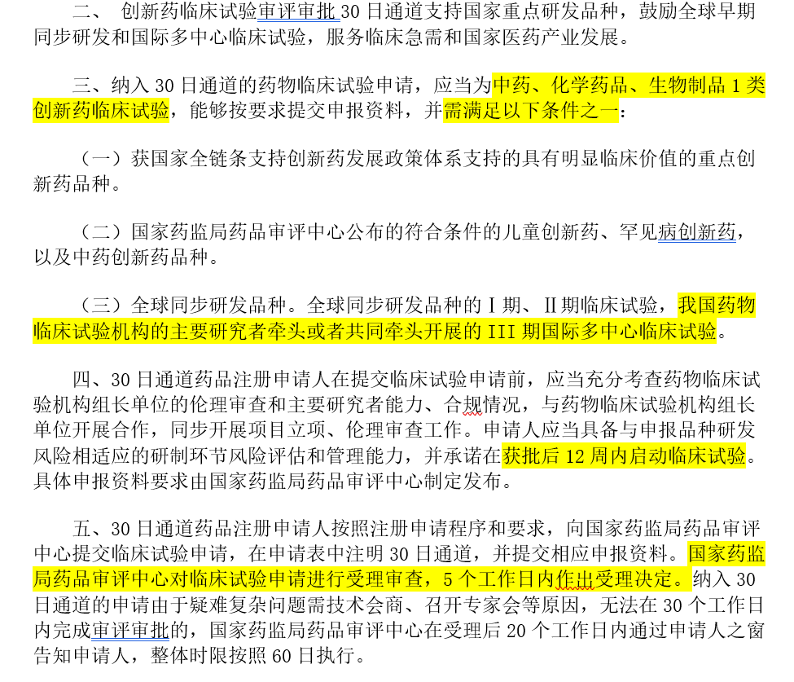

Slide 89
Leading PI information collection & evaluation (only for internal reference)
Potential investigator name** | Hospital/ department | Academic experience, especially in clinical studies(weight 15%**) | Impact in Therapeutic Area (weight 20%**) | Leading PI feasibility(weight 30%**) | Leading site start up timeline feasibility(weight 35%**) | Total Grade | Finial proposal for leading PI selection (Y/N)
张惠杰 | 复旦大学附属中山医院/内分泌科 | Grade: 12 Former Associate Head of Endocrinology Department at Nanfang Hospital Postdoc experience at Tulane University School of Public Health Limited PI experience, e.g. mazdutide/Innovent, a few obesity trials sponsored by local companies 50+ publication on Pubmed Research focus: Mechanisms and Intervention Strategies of Metabolic Diseases | Grade: 15 New Department Head of Endocrinology Member of Endocrinology Branch of the Chinese Medical Association（中国医师协会内分泌分会） Member of Chinese Diabetes Society (中华医学会糖尿病学分会） | Grade: 21 Prof. Zhang Huijie, 45 years old No Leading PI experience， Limited PI experience，PI of mazdutide in MAFLD Transition between Prof. Li is not announced. | Grade: 30 GCP set up and review, It routinely takes 1 week, if it required EC is in parallel to CTA, may apply for EC and HGRAC firstly. and then proceed the setting-up process. Site is highly motivated with 30 days CTA application. 2. EC it's feasible to keep EC in parallel to CTA.It routinely takes 1 month 3. HGRAC. It takes 1-2 weeks for HGRAC application and 1-2 weeks for obtaining the signature and seal, this site has previously applied for HGRAC exportation and obtained approval. The CIQ account is available in this site. 4. Contract. The site contract review takes 1-2 weeks, and the contract seal takes 1-2 weeks. The down payment requires a complete and assessable subject fee. To sum up, the timeline of the SSU in this site meets the 6 months benchmark of BI, usually take 4 months | 78 | N

Slide 90
Leading PI information collection & evaluation (only for internal reference)
Potential investigator name** | Hospital/ department | Academic experience, especially in clinical studies(weight 15%**) | Impact in Therapeutic Area (weight 20%**) | Leading PI feasibility(weight 30%**) | Leading site start up timeline feasibility(weight 35%**) | Total Grade | Finial proposal for leading PI selection (Y/N)
李小英 | 复旦大学附属中山医院/内分泌科 | Grade: 14 Postdoc fellow at Baylor College of Medicine, USA in 1998-2000 and in McGill University, Canada in 2000-2003 Leading PI of 28 clinical trials as per the CDE website, including semaglutide/Novo Nordisk, tirzepatide/Lily, AZD6234/AZ, survodutide/Boehringer etc. 100+publications on Pubmed Research focus: Obesity, fatty liver diseases and type 2 diabetes. | Grade: 16 Former Department Head of Endocrinology Former Vice Chair（前任主委）of Chinese Diabetes Society (中华医学会糖尿病学分会） | Grade: 24 Prof. Li Xiaoying, 65 years old Prof. Li Xiaoying with rich clinical trial experience, he is the leading PI of Synchronize-CVOT study(1404-0040). The PI is highly motivated, very supportive of BI projects, and cooperative during visits. | Grade: 30 GCP set up and review, It routinely takes 1 week, if it required EC is in parallel to CTA, may apply for EC and HGRAC firstly. and then proceed the setting-up process. Site is highly motivated with 30 days CTA application. 2. EC it's feasible to keep EC in parallel to CTA. It routinely takes 1 month 3. HGRAC. It takes 1-2 weeks for HGRAC application and 1-2 weeks for obtaining the signature and seal, this site has previously applied for HGRAC exportation and obtained approval. The CIQ account is available in this site. 4. Contract. The site contract review takes 1-2 weeks, and the contract seal takes 1-2 weeks. The down payment requires a complete and assessable subject fee. To sum up, the timeline of the SSU in this site meets the 6 months benchmark of BI, usually take 4 months | 82 | N

Slide 91
Leading PI information collection & evaluation (only for internal reference)
Potential investigator name** | Hospital/ department | Academic experience, especially in clinical studies(weight 15%**) | Impact in Therapeutic Area (weight 20%**) | Leading PI feasibility(weight 30%**) | Leading site start up timeline feasibility(weight 35%**) | Total Grade | Finial proposal for leading PI selection (Y/N)
毕艳 | 南京鼓楼医院 | Grade: 11 Focuses on clinical and basic research in diabetes and obesity, yielding numerous original findings. Has published 65 SCI papers as first or corresponding author in journals such as the Journal of Hepatology, Diabetes Care, Nature Communications, and Diabetes. Has undertaken one key project funded by the National Natural Science Foundation of China. | Grade: 13 Member of the Chinese Diabetes Society Deputy Head of the Obesity and Diabetes Group of the Chinese Diabetes Society (中华医学会糖尿病学分会肥胖与糖尿病学组副组长) | Grade: 22 Only lead one ph1/2 local PK study信达-玛仕度肽in 2025 | Grade: 31 GCP set up and review, from document submission to approval, it will always take 10 working days. EC requires CTA acceptance number to initiate the EC submission and EC meeting is held every Tuesday then there are 3-4 meeting times each month but the successful rate of one -time approval is 84% and always need 2nd review. Best case for the EC review and approval is 10 working days and base case for EC approval is 30 calendar days. HGRAC application can be submitted after GCP approval and will take at least 7 working days to get the stamped form. Contract. Site contract review can be initiated after EC approval, which always takes 10 working days, but site is used to raise comments for investigator fee. Contract signing always takes 20 working days. Depends on the availability of hospital director (maybe the process can be accelerated since Yan Bi performed as one of the hospital director needs to sign the contract) SIV preparation，GCP QC should be done prior to SIV, always take 1 week. Generally, best case for SSU completion will take 74 days(2.5 months), including GCP +EC + CTA= 7+15+45+7，base case will take 96 days(3.2months) including GCP +EC + CTA =14+30+45+7. | 76 | N

Slide 92
Leading PI information collection & evaluation (only for internal reference)
Potential investigator name** | Hospital/ department | Academic experience, especially in clinical studies(weight 15%**) | Impact in Therapeutic Area (weight 20%**) | Leading PI feasibility(weight 30%**) | Leading site start up timeline feasibility(weight 35%**) | Total Grade | Finial proposal for leading PI selection (Y/N)
刘 铭 | 天津医科大学总医院/内分泌科 | Grade: 12 Former Associate Professor of Division of Metabolism, Endocrinology and Diabetes, University of Michigan, US Leading PI of 19 clinical trials, all sponsored by local companies. PI of obesity trials including tirzepatide/Lily, CagriSema /Novo Nordisk, Orforglipron/Lily, AZD5004/AZ, mazdutide/Innovent, survodutide/Boehringer 200+ publications on Pubmed Research focus: Islet function and the pathogenesis of diabetes, monogenic diabetes, pituitary and adrenal diseases | Grade: 15 Head of Endocrinology Department Deputy Director (副主委) of Chinese Society of Endocrinology（中华医学会内分泌学分会）, and Head of the Endocrine Rare Diseases Group | Grade: 25 Prof. Liu Ming, 60 years old. Rich clinical trial experience, he took 19 trials as leading PI. Per investigation in chinadrugtrials.org.cn, there are 4 Obesity related trials are ongoing for recruitment. BI Kept good communication with Prof. Liu Ming. | Grade: 28 1. GCP set up and review, It routinely takes 2 week. For the 30 days CTA process, site disagree to follow the new process until further instructions from site high level. 2. EC, It routinely takes 1-1.5 month. it's feasible to keep EC in parallel to CTA, Leading site EC approval and CTA approval is not needed anymore. 3. HGRAC. It takes 2 weeks for HGRAC application and 2 weeks for obtaining the signature and seal, this site has previously applied for HGRAC exportation and obtained approval. The CIQ account is available in this site. 4. Contract. HOPE site. but the site currently prefers to suspend the MSA and review contracts through the regular process. Specific requirements may need further negotiation (according to new site SOP requirements in September). The site contract review takes 5-6 weeks, and the contract seal takes 2 weeks. The down payment requires a complete and assessable subject fee. To sum up, the timeline of the SSU in this site meets the 6 months benchmark of BI, usually take 5 months from CTA-S as leading site | 80 | N
Notes:
MSA推翻 目前确定不可走新CTA流程

Slide 93
BI 3802876 (FAP/TRAILR2)

Slide 94
TA Portfolio Key Update- BI 3802876 (FAP/TRAILR2)— MASH cirrhosis
Asset Name-MoA | Indication | China Approval (base case) | Update | Next Step
BI 3802876 (FAP/TRAILR2 biospecific antibody) MOA: halt/reverse liver fibrosis by removing FAP+ TRAILR2+ activated Hepatic Stellate Cells | MASH cirrhosis | Aug 2037 | <Global status> Phase 2a recruitment delay: only three to four sites activated and four patients screened (all screen failures). Revisit the timeline in mid May based on IQVIA new projection. 26W Tox waiver initiative update: starting with the FDA and awaiting FDA feedback before engaging with other agencies such as EMA and Asian health authorities. | Potential protocol modifications are being considered to relax certain criteria and improve feasibility.
 |  |  | <China status> Currently keep the pre-IND kick-off timeline in Jun 2026​ Further check the CTA submission timeline | Meeting with Global and Japan for progress update in May.

Slide 95

PhIIa SRD and PhIIb assessing BI 3802876 (FR) in MASH cF4
Inflection Point 1: Ph IIa interim data to trigger PhIIb planning
Feb ‘26
Mar ‘27
Jan ‘28
Sep ‘29
Jul ‘30
Ph IIa in cF4
1
Ph IIa interim data
DEC 2/3
Ph IIb in cF4
DG3
PoC
FR (i.v.)
BI 3802876
DEC 1/2
DG2
DG1
26 Week GLP-Tox
Value assessment: IV vs SC
1
…establish PD-data and improve benefit-risk profile
Pro-C3 reduction: anticipated strong signals and sustained response after single dose
Additional NIT-data: ELF, VCTE, HSC-activity in MASH cF4 patients
→Mechanistic plausibility of MoA
Inflection point 1 will …
…kick-off FR PhIIb planning
PhIIa data to support dosing selection and frequency
Request for relaxation of I/E criteria

Slide 96
BI 3804379 (IL-11)

Slide 97
TA Portfolio Key Update- BI 3804379 (IL-11) in MASH cirrhosis
Asset Name-MoA | Indication | China Approval (base case) | Update | Next Step
BI 3804379 (IL-11) MOA: Anti-IL11 directly reduces fibrosis and preserves/restores hepatocyte health in the liver | MASH cF4 | 2037 | <Global status> SRD/MRD trial completed in Mar. Phase 1 patient cohort to be initiated in Jun Japan team will have PMDA consultation on phase 1 backloading in Sep this year
 |  |  | <China status> China integration will start from the PoC phase in 2028. Phase 1 strategy (including HA interaction ) to be discussed . | To determine the phase 1 HA interaction plan

Slide 98
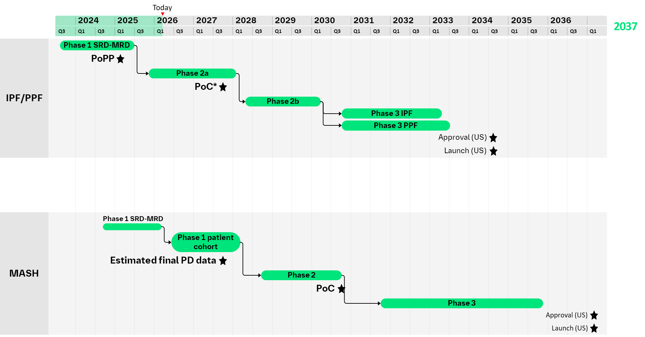
IPF/PPF & MASH Timelines for Clinical Development Programs
IPF/PPF
Phase I SRD/MRD completed
  IL11i – FR safe and tolerable
Ph II 1493-0002 (2500 mg IV Q4W)
in progress
  42 screened, 18 randomized
  PoC – Q4 2027
  Launch – Q3 2034
*planned; pending IUEC approval
MASH
Phase I SRD/MRD completed
  IL11i – NG safe and tolerable
Patient cohort for will be submitted April/26, FPI planned for Jun/26
  PoC- Q4 2030
  Launch – Q1 2037
Notes:
You see the high level development plans for both programs shown here. IPF is currently conducting a Ph IIa PoC study. MASH is about to initiate an inpatient cohort in the MRD. PoC and Lauch for the two compounds is separated by ~ 3 years.

Slide 99
Summary
FR s.c. formulation is possible in IPF/PPF but not in MASH
NG s.c. allows monthly rather than weekly dosing
 | FR (BI 765423) s.c. IPF/PPF | NG (BI 3804379) s.c. MASH or IPF/PPF
Human dose estimate | ~ 150 mg Q1W | ~ 110 mg Q4W
FR s.c. possible for IPF/PPF (Q1W)
  Simulations show feasibility of weekly s.c. dosing in IPF/PPF
NG s.c. possible for IPF/PPF & MASH (Q4W)
  MRD indicate feasibility of monthly s.c. dosing in IPF/PPF and MASH
Notes:
Minimal dose for FR s.c. in MASH: 750 mg Q4W, 100 mg Q1W - not feasible with autoinjector / pen (limited volume) and TPP respectively

